Slide 1
Global Business Leadership
Information Session
https://www.csbsju.edu/global-business-leadership

Slide 2









The world needs global business leaders
Global Competition
Global Sourcing/Supply Chain/Manufacturing
Diverse Talent Pool
Managing Expatriates
Global Trade/Politics/Issues
Global Customers

Slide 3

What differentiates our program?
Broad-Based Approach
Global Focus
Computer Proficiency
Guest Speakers – Common Days
Internships Abroad
Study Abroad Business Classes

Slide 4
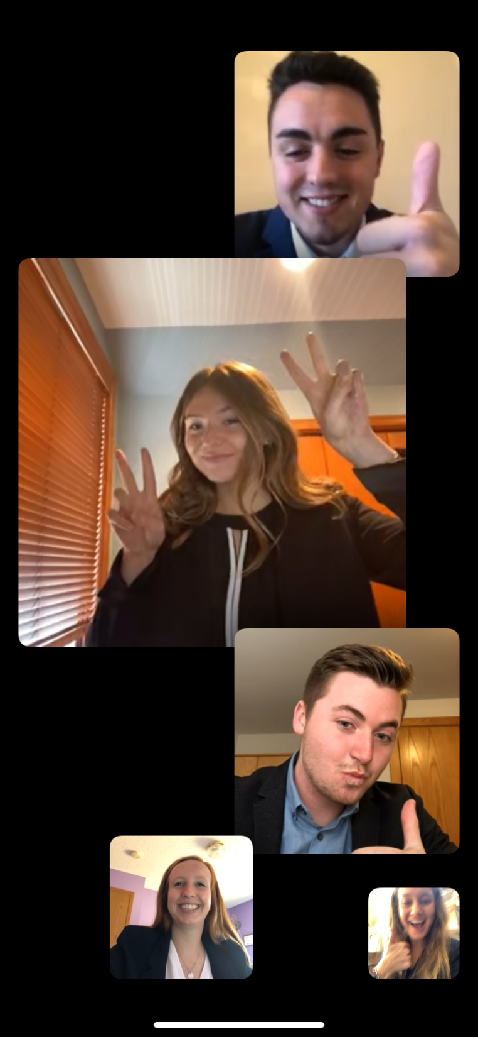
What differentiates our program?
Student Clubs
  Bennies in Business
  Enactus
  Breakfast Club
  Mayo Scholars
  Case Study Research Team (S.A.M.)
  Square One
  Extending the Link
Research Opportunities
On-Campus Businesses
  Clemens Perk
  The Schu Coffee
  T-Spot
Integrated Class Projects

Slide 5


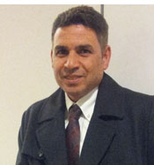
We are passionate about teaching and research
Julie Fisk, Visiting Adjunct Instructor
Juris Doctorate, University of Minnesota Law School
John Hasselberg, Professor
Juris Doctor, University of Minnesota Law School
Hassan Hussein, Visiting Assistant Professor
Ph.D. University of Minnesota, MN

Slide 6



We are passionate about teaching and research
Paul Marsnik,
Professor
Ph.D., University of Nebraska
Sanford Moskowitz Associate Professor
Ph.D. Columbia University, NY
Kingshuk Mukherjee, Associate Professor
M.B.A. Coventry University, Coventry, England

Slide 7
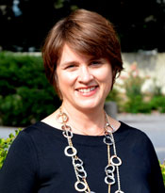
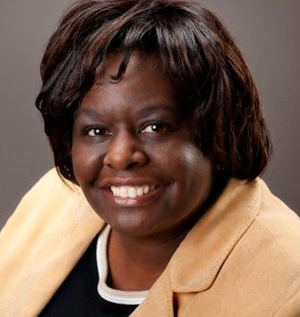

We are passionate about teaching and research
Margrette Newhouse, Director McNeely Center M.B.A. Carlson School of Management, University of Minnesota
Deborah Pembleton, Associate Professor
Ph.D. University of Minnesota
Steve Schwarz, Visiting Assistant Professor
M.B.A. University of Montana

Slide 8
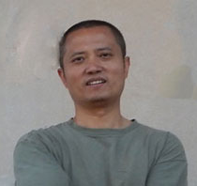


We are passionate about teaching and research
Qiang (Tony) Yan, Associate Professor
Ph.D. New Mexico State University
Ph.D. University of Missouri - St. Louis
David Zoeller,
Visiting Assistant Professor
M.A. University of Minnesota
Mary Jepperson, Professor
Department Chair
MBA St. Cloud State University

Slide 11
Our curriculum starts with a series of four fabulous classes
Fall Semester
Spring Semester
GBUS 210: The Strategic Environment
  Strategic Environment
  Intercultural Management
  Global Management
GBUS 230: Decision Making Methods
  Research Design
  Statistical Analysis
  Business Communication Tools
GBUS 220: People in Organizations
  Leadership
  Creativity
  Ethics
GBUS 240: Tools of Analysis
  Tools of Analysis - Excel
  Finance
  Data Analysis

Slide 12
We focus on six key attributes
  Engagement
  Connection
  Teamwork
  Community
  Breadth of knowledge
  Cognitive flexibility
  Internship preparation

Slide 13
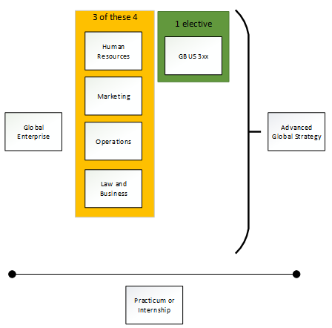
And your education continues with 300-level courses

Slide 14
Here is a sample 4-year plan

Slide 15
Questions?

