Slide 1
Donald M. Neely Center
The Entrepreneurial Leadership Series
Stuart C. Harvey, Jr. ‘83
Executive Chairman
Ceridian HCM

Slide 2
ENTREPRENEURSHIP
The process of starting a business or other organization
Develops business model, acquires human and other required resources, and is fully responsible for its success or failure

Slide 3
Characteristics, Traits, Attitudes:
“Flow”
Occurs when an individual forgets about the outside world given a powerful insight.
Determination to Succeed
“I have not failed. I’ve found 10,000 ways that won’t work.” Thomas Edison
Patience
“Success is walking from failure to failure with no loss of enthusiasm.” Winston Churchill
Problem Solver
“You can’t ask customers what they want and then try to give that to them. By the time you get it built, they’ll want something new.” Steve Jobs
Energy
“I can accept failure, everyone fails at something. But I cannot accept not trying.” Michael Jordan
Confidence
“Whether you think you can or you can’t you’re right.” Henry Ford

Slide 4
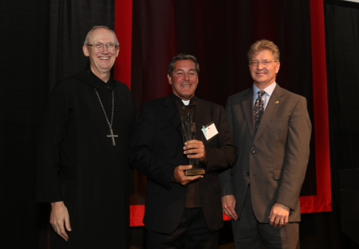
Pax Christi Award Fr. Richard Frechette – Passionist Priest and Medical Doctor
Highest Honor Awarded by Saint John’s

Slide 5
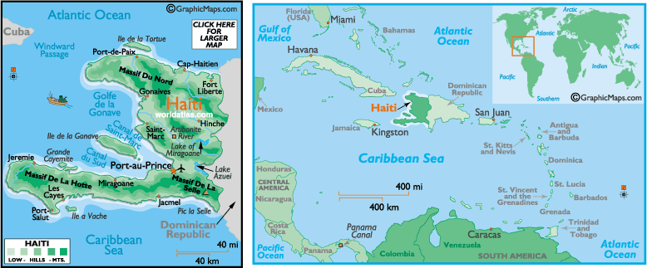
Geography - Haiti
Haiti is a Caribbean country; it occupies the Western portion of the island of Hispaniola (the Dominican Republic occupies the other half), and is about 45 miles from Cuba, and 710 miles from Miami.

Slide 6
Overview
Haiti is a former French slave colony; and gained independence through a slave rebellion in 1804. First official Black Republic.
90-95% of population is of predominantly African descent; and millions of Haitians live abroad
Haiti has a history of oppressive dictators, and unstable and corrupt governments
Haiti frequently experiences natural disasters such as hurricanes
Haiti has very limited infrastructure (physical, economic, government, education)

Slide 7
By the Numbers
Demographics
Economics
 | Haiti | United States
Population | 9.88 million people | 312 million people
Population density | 928 people/m² | 88.1 people/m²
Life expectancy | 60.8 years | 78.1 years
Median Age | 20.2 years | 36.7 years
 | Haiti | United States
GDP | $7.077 billion per year | $14.1 trillion per year
GDP per capita | $716.51 per person | $45,230 per person
unemployment rate | 80-90% | 6.7%
Most of Haiti’s 10m population survives on
less than $2 per day
Most Haitians have no opportunity for employment
A Haitian’s life expectancy is 18 years less than that of someone born in the US

Slide 8
More Facts
Only 10% of Haitians have electrical service
Haiti has one of the highest rates of HIV/AIDS cases outside sub-Saharan Africa. 2.2% of adults (age 15-49) are living with AIDS
Haiti is the poorest country in the Western Hemisphere
Haiti has 50% illiteracy
Haiti has consistently ranked among the most corrupt countries in the world
One Physician for every 15,000 people.
And this was all BEFORE January 12th, 2010

Slide 9
January 12th, 2010
7.0 magnitude earthquake

Slide 10
Devastation
Over 250,000 people dead; over 300,000 injured, over 1.5 million people left homeless.
The government is incapable of governing; slum gangs are filling the void; and survivors are suffering from chronic disease and malnutrition.
NGO’s struggle in their efforts, and there is significant waste and inefficiency; there is no foothold on which the UN and others can anchor efforts. Many areas post earthquake are without government infrastructure – no hospital, no police, no schools.
Haiti in process - completely rebuild its government, infrastructure and economy; and will be dependent on international financial, humanitarian, and security assistance for the foreseeable future.

Slide 11
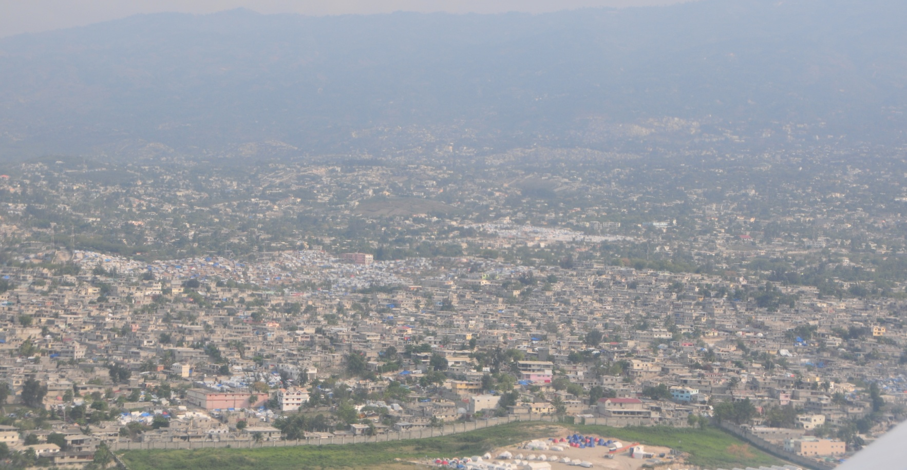
Destruction
Port au Prince – near total destruction
Slums, Tent Cities

Slide 12
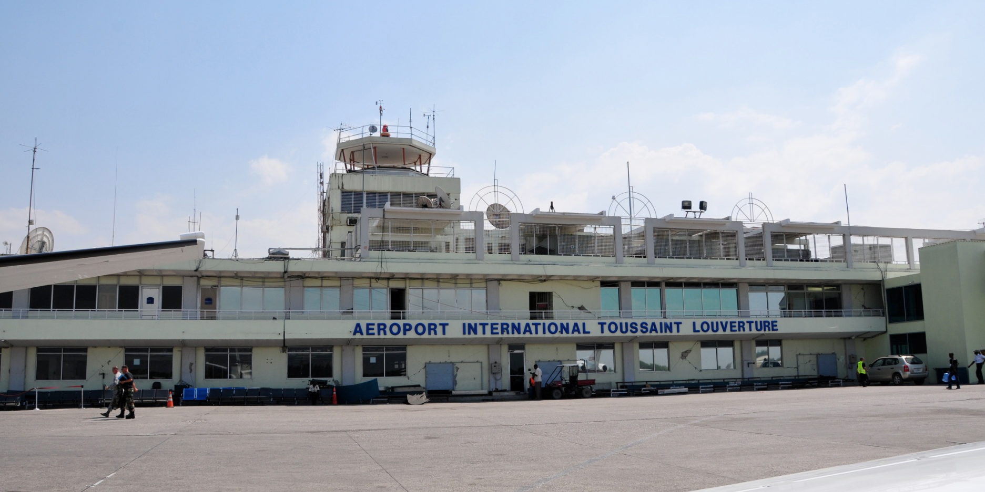
Port-Au-Prince Airport

Slide 13
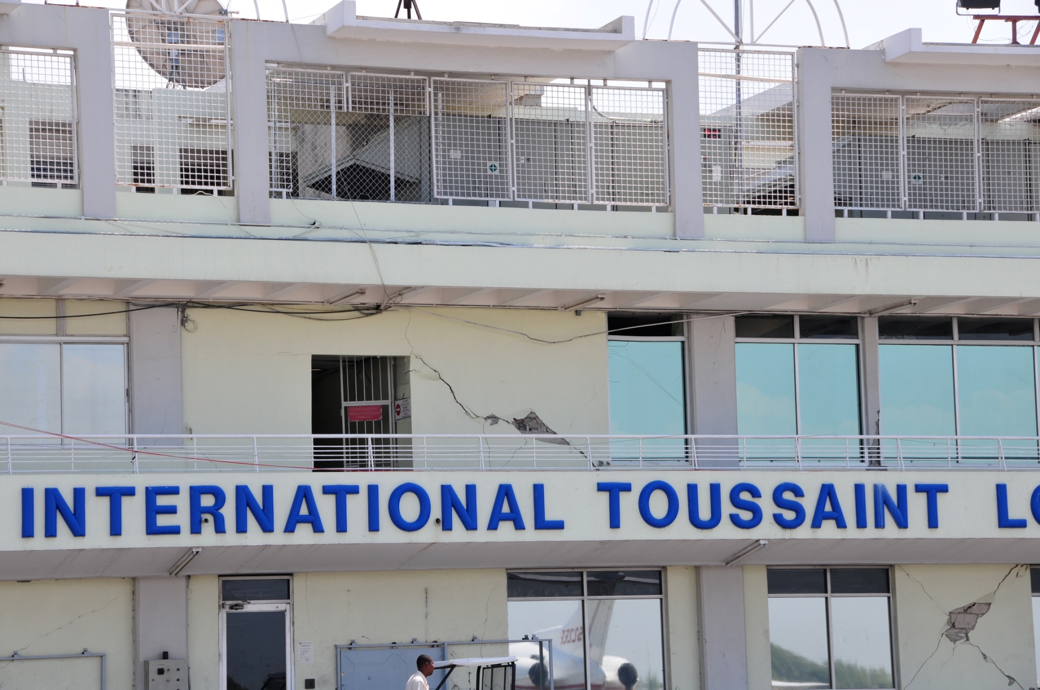

Slide 14
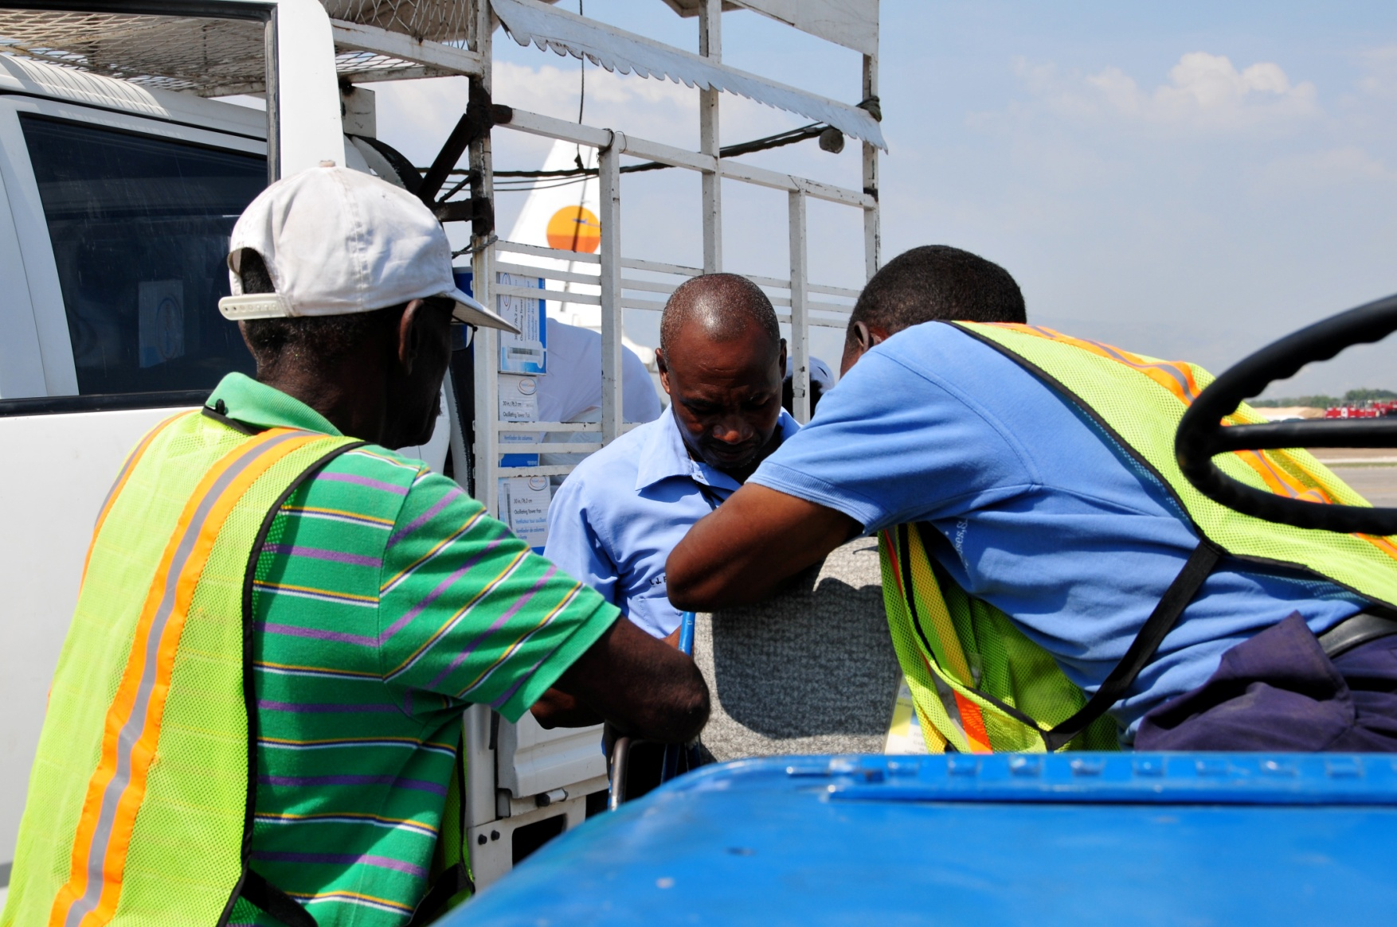
Customs

Slide 15
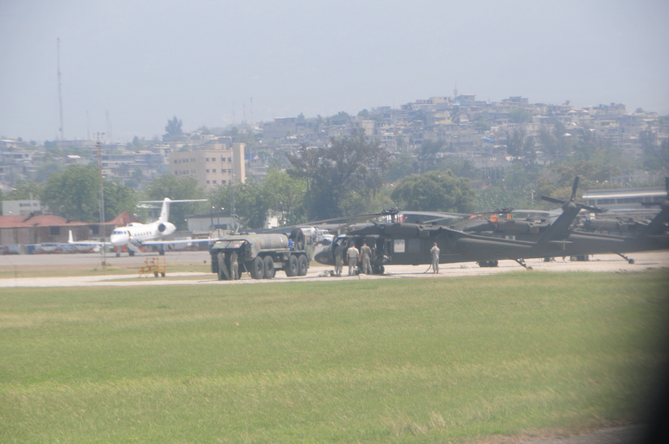

Slide 16
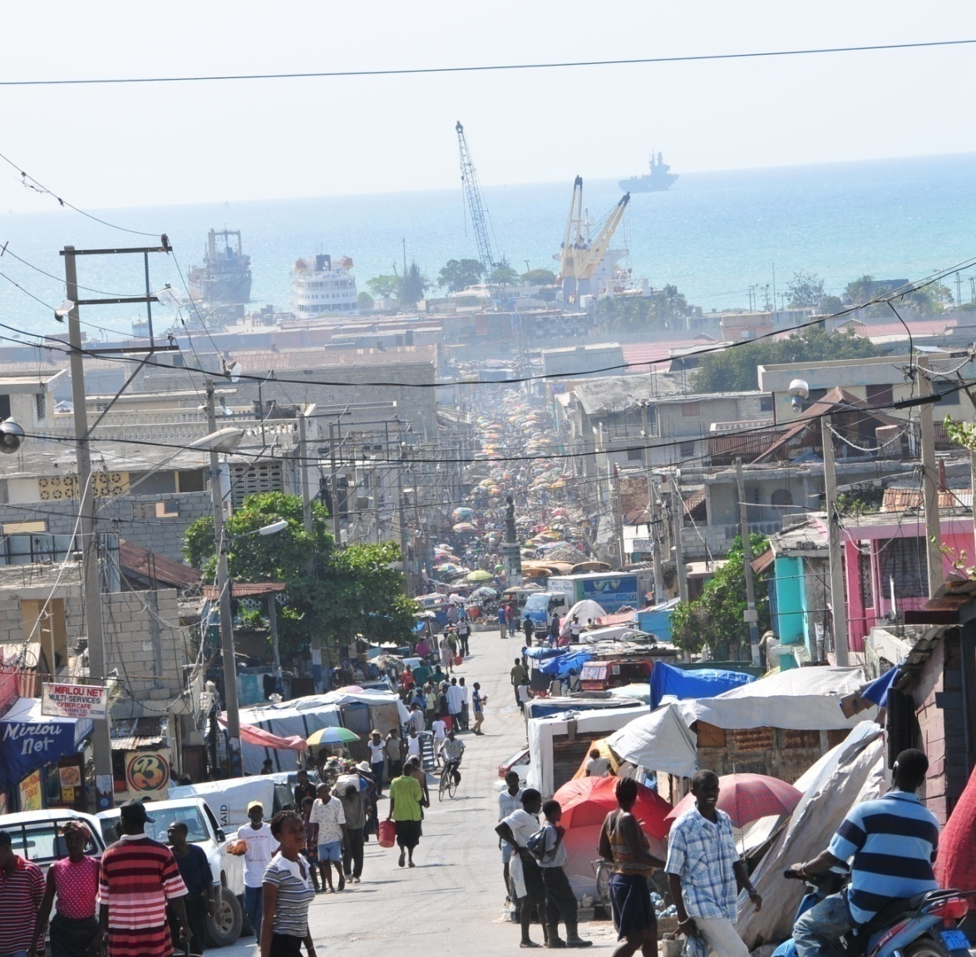
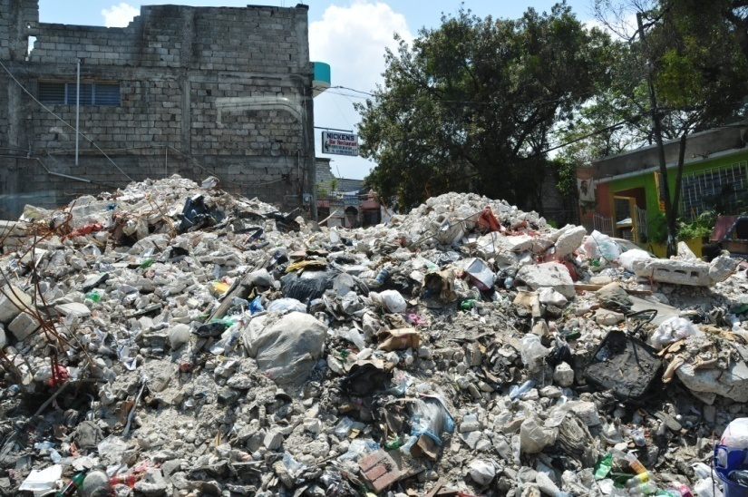
Squalor
People living on the street
The view towards the Port
A graveyard
A common sight

Slide 17
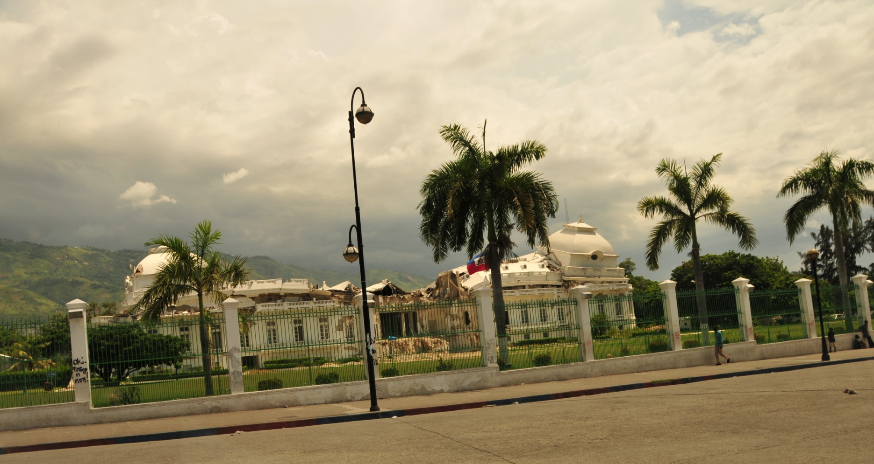
Presidential Palace

Slide 18
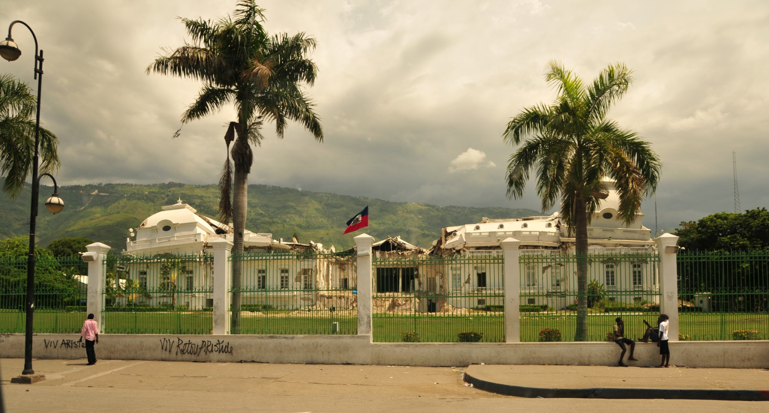

Slide 19
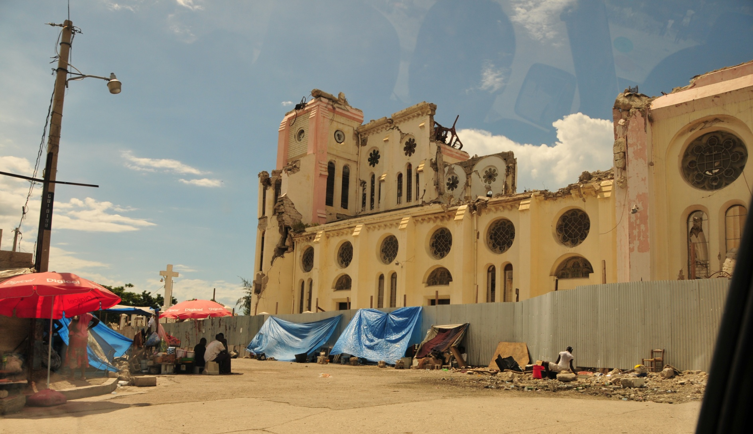
Cathedral

Slide 20
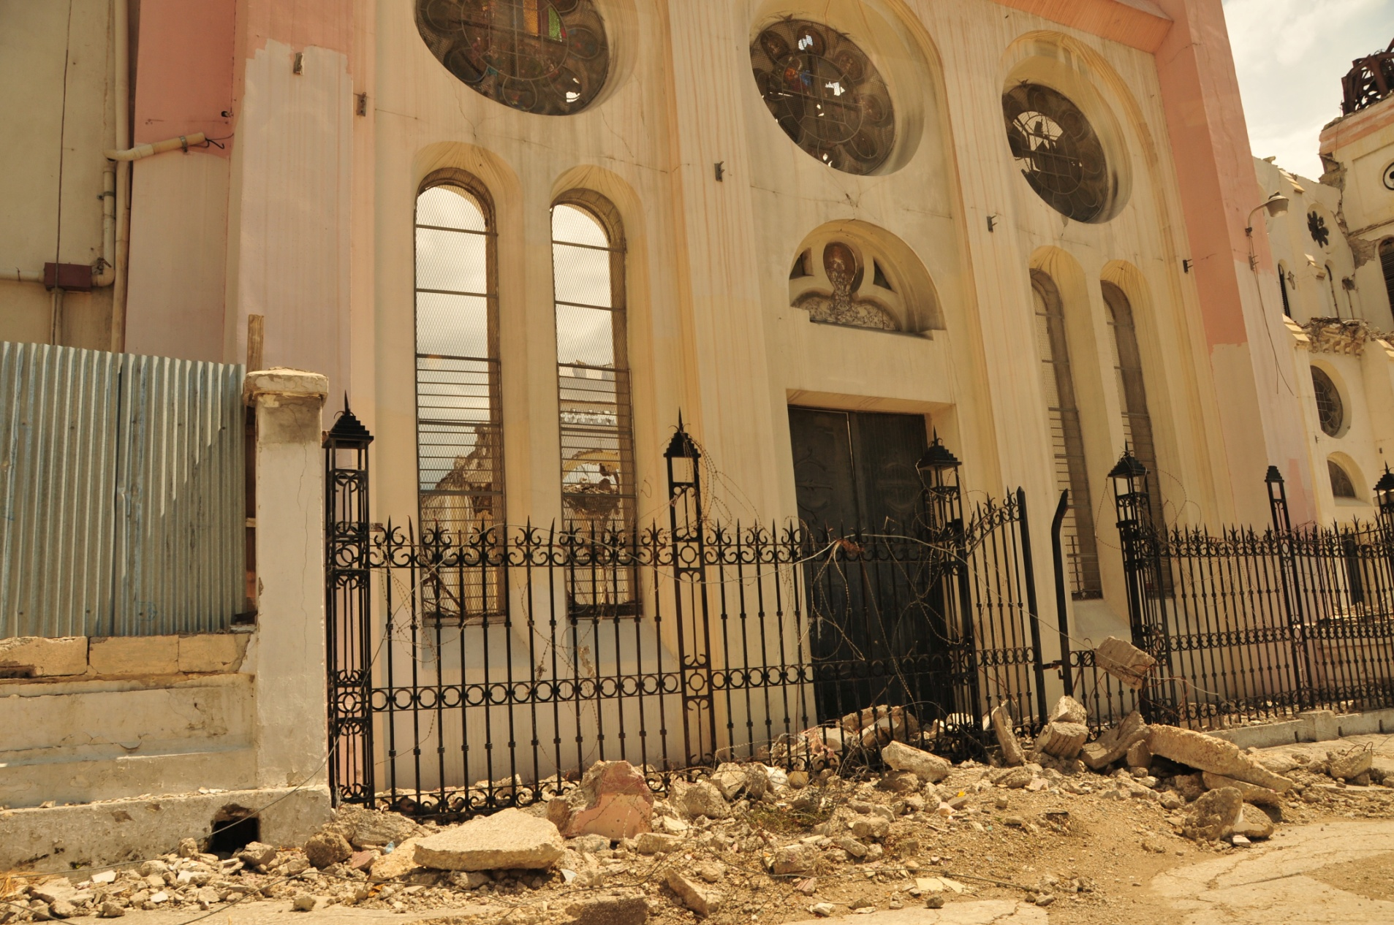

Slide 21
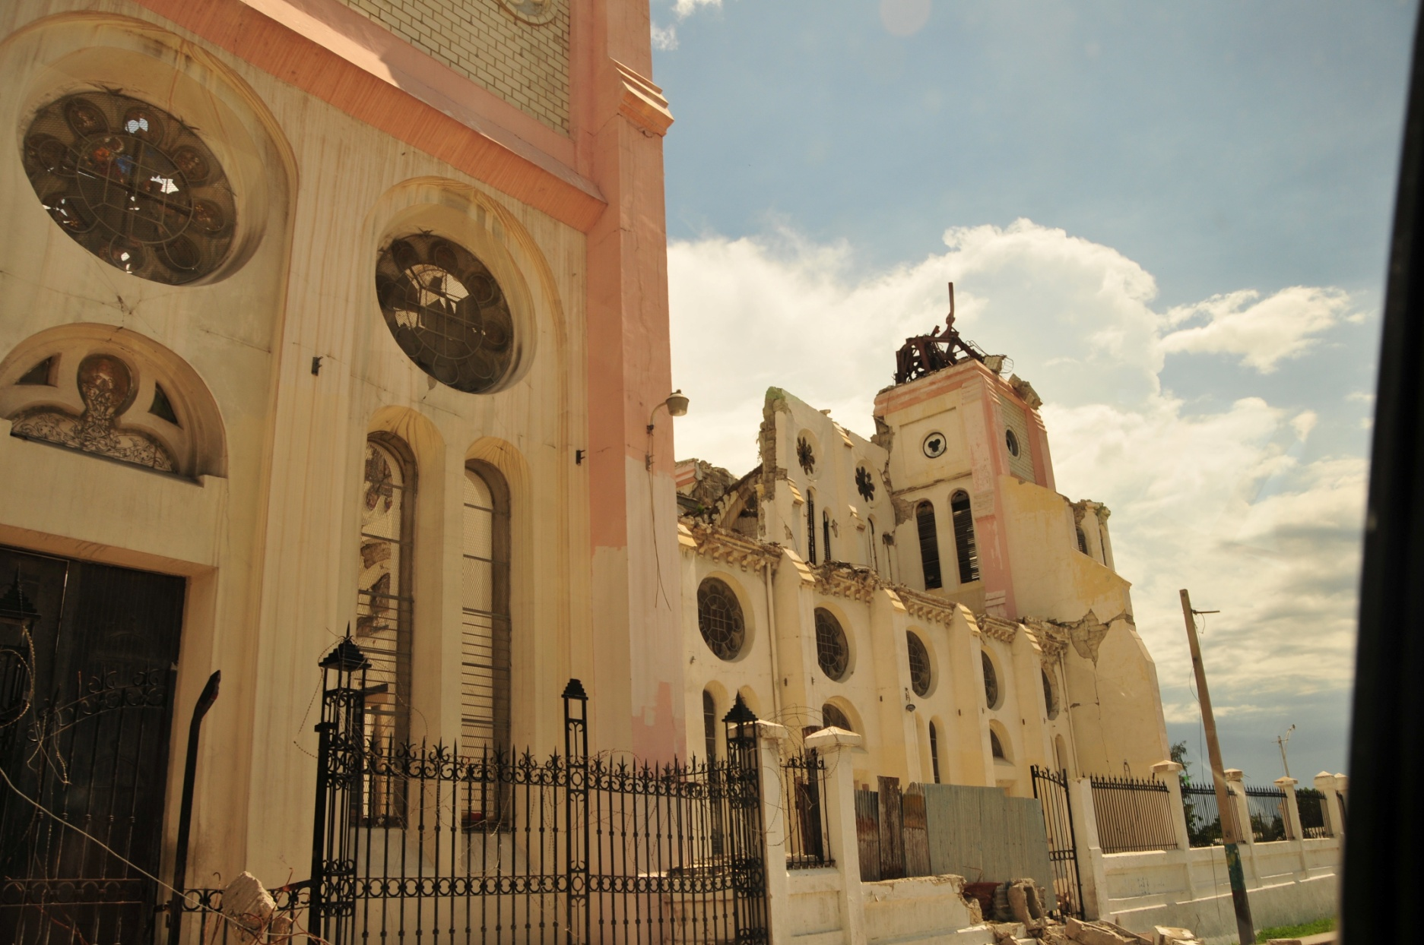

Slide 22
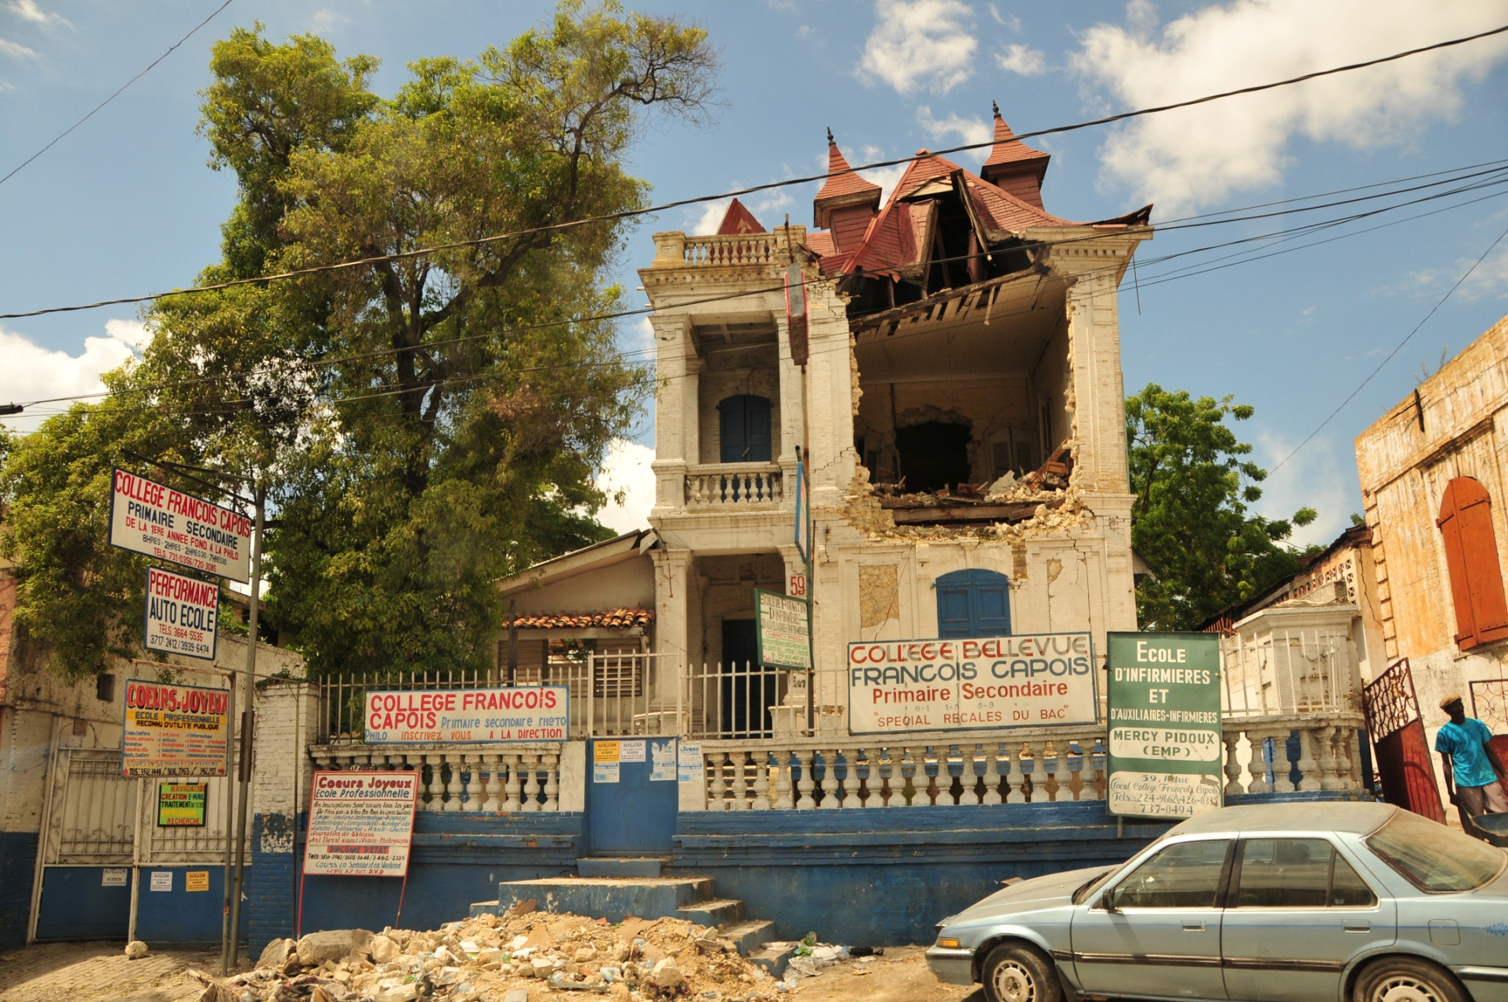
Elementary School

Slide 23
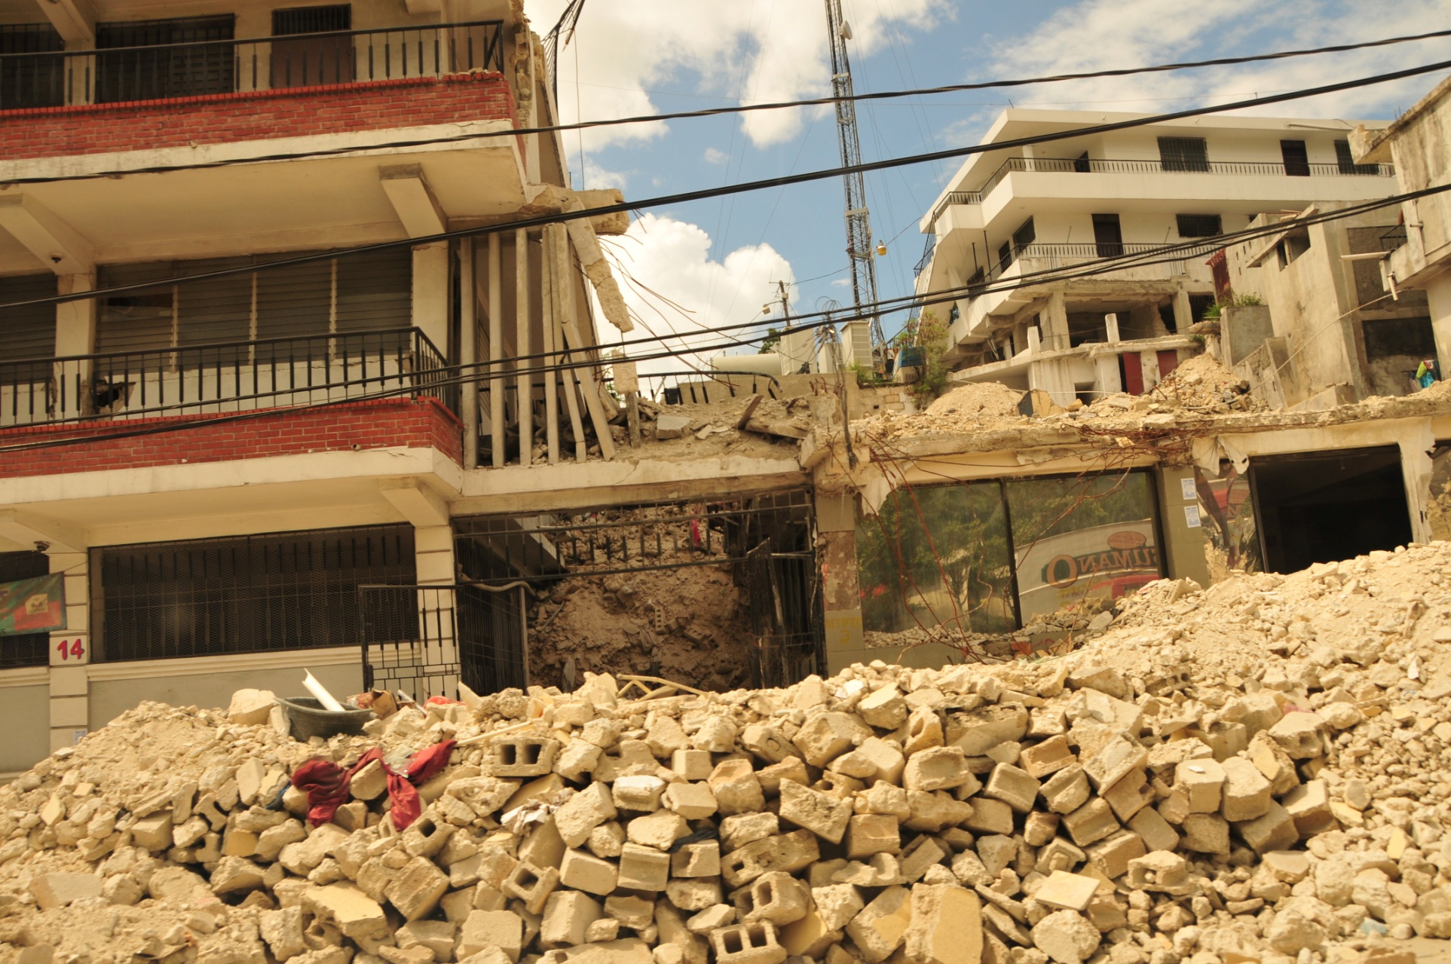
Retail Shops

Slide 24
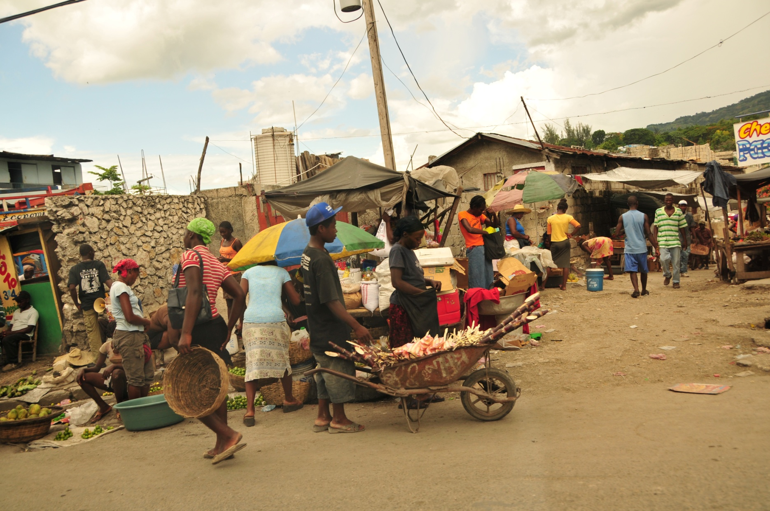
Micro Economy

Slide 25
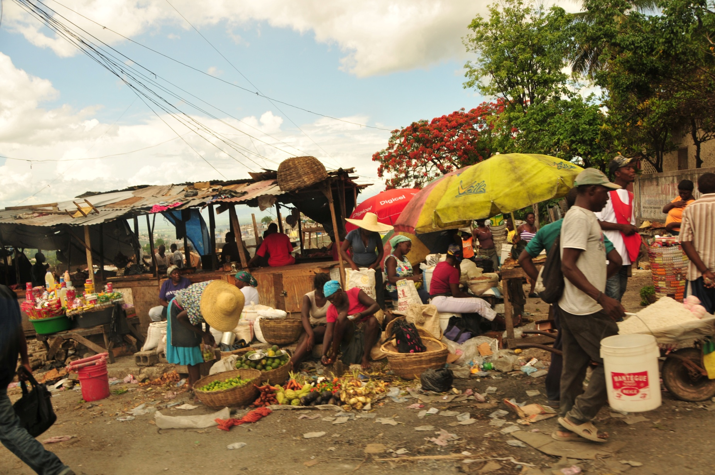

Slide 26
But…there is inspiration and hope
Nuestros Pequeños Hermanos
Nos Petit Frères et Sœurs

Slide 27
NPH – Haiti Initiative
NPH is a 50 year old international organization that has an established presence across 9 countries in Latin America and the Caribbean, one of which is Haiti
NPH has been in Haiti for 27 years, and is one of the few established and trusted services in the country. NPH controls the complete vertical, from funds acquisition to program management, with ex- pequeños filling many positions on the ground
In Haiti, NPH provides these services:
Medical Center: St Damien
Orphanage: Kay St Elen
Outreach Program: St Luke
Economic incubator: “Francisville”
NPHis staffed by truly remarkable people – Its Haitian director: Fr Rick Frechette

Slide 28
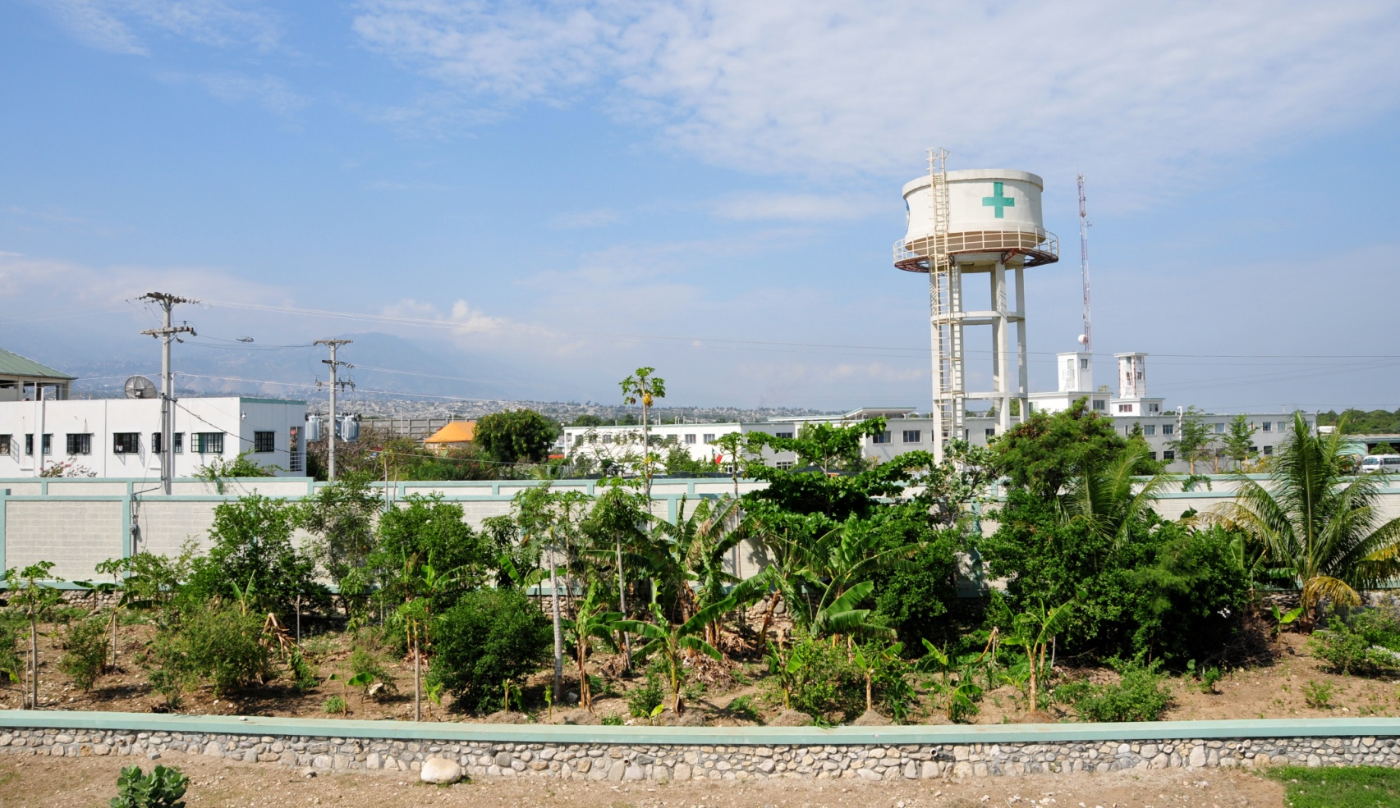
St. Damien Medical Center

Slide 29
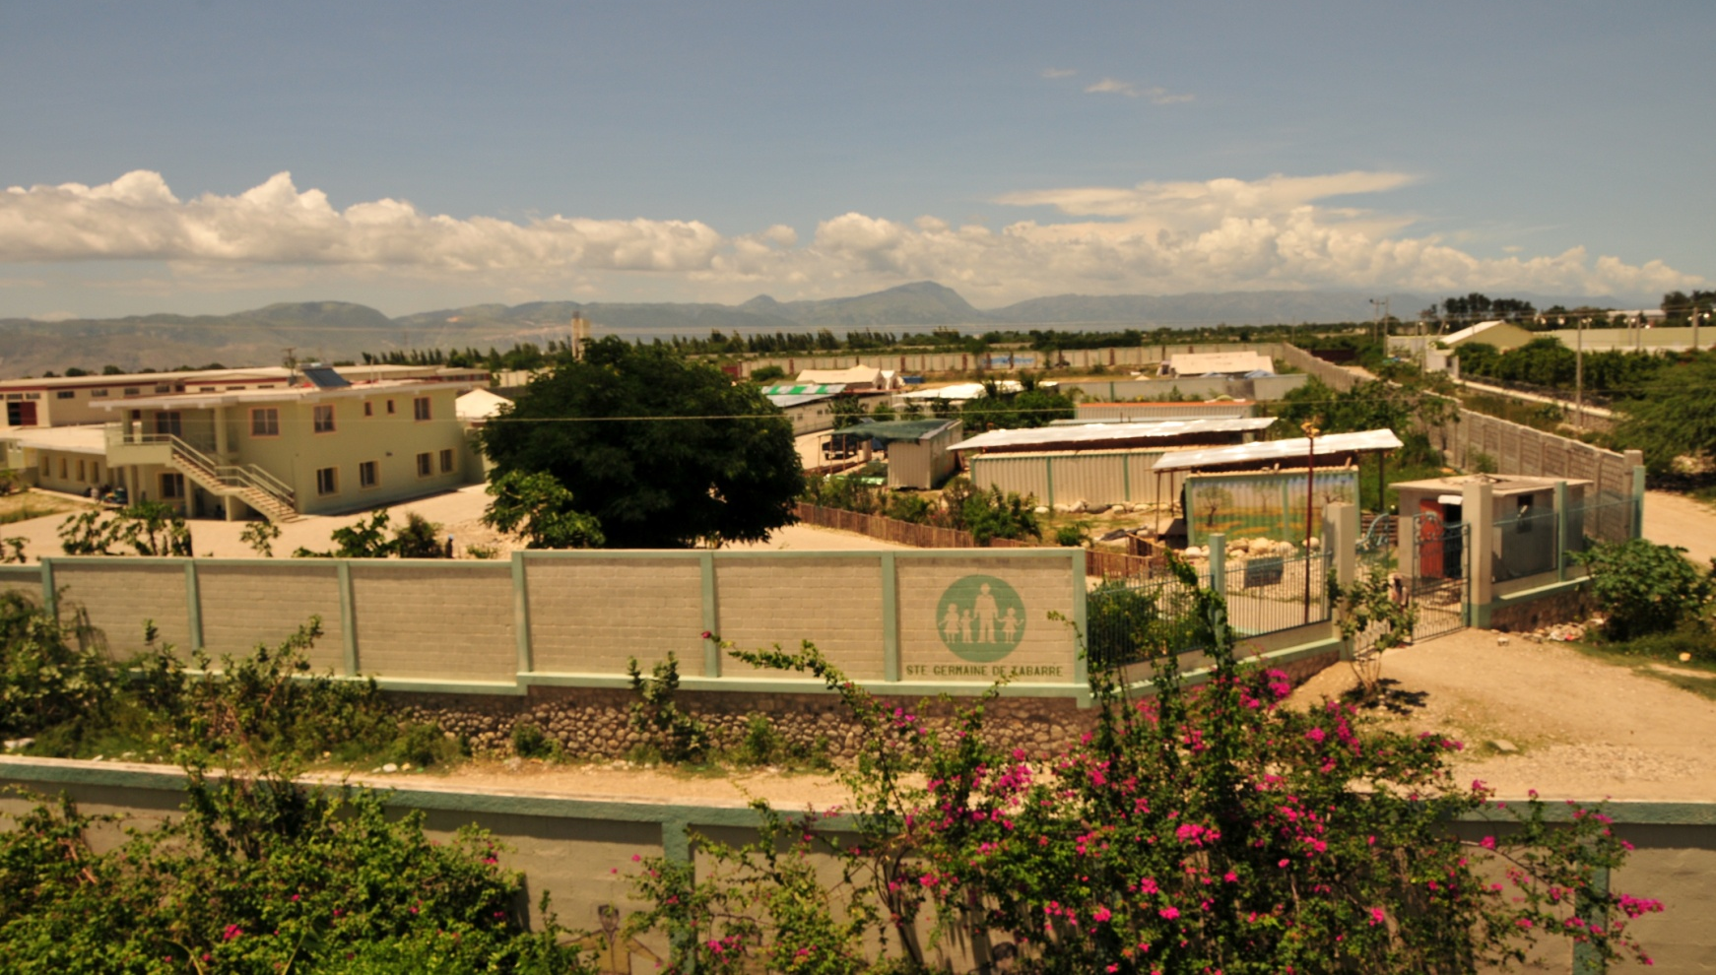
St. Damien Medical Center

Slide 30
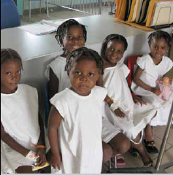
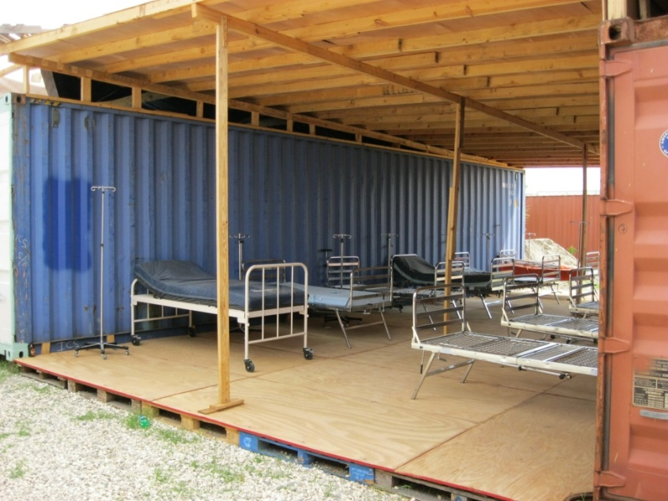
Medical Center
Patients
The Medical Center caters to 100s of children daily, and houses 20 children who are suffering from chronic conditions. The Center includes a surgery ward, a cancer ward, a HIV clinic, and a rehabilitation and educational center for disabled children.
Since the earthquake, NPH has had to be creative in its use of resources – shown here is a makeshift ward consisting of temporary roofing over adjacent trailers. Every square inch of the Medical Center’s courtyard is filled with people in desperate need.
Temporary Ward
Select Expenses | Annual Budget (pre-Earthquake)
Paediatric Hospital | $1,500,000
Surgery Ward | $500,000
Cancer Ward | $300,000
HIV Clinic | $500,000
Street Clinics | $244,000
Sample Salaries | Per Day
Nurse | $15
Lab Tech | $8
Driver | $7
Social Worker | $8
Cook, Maintenance | $6

Slide 31
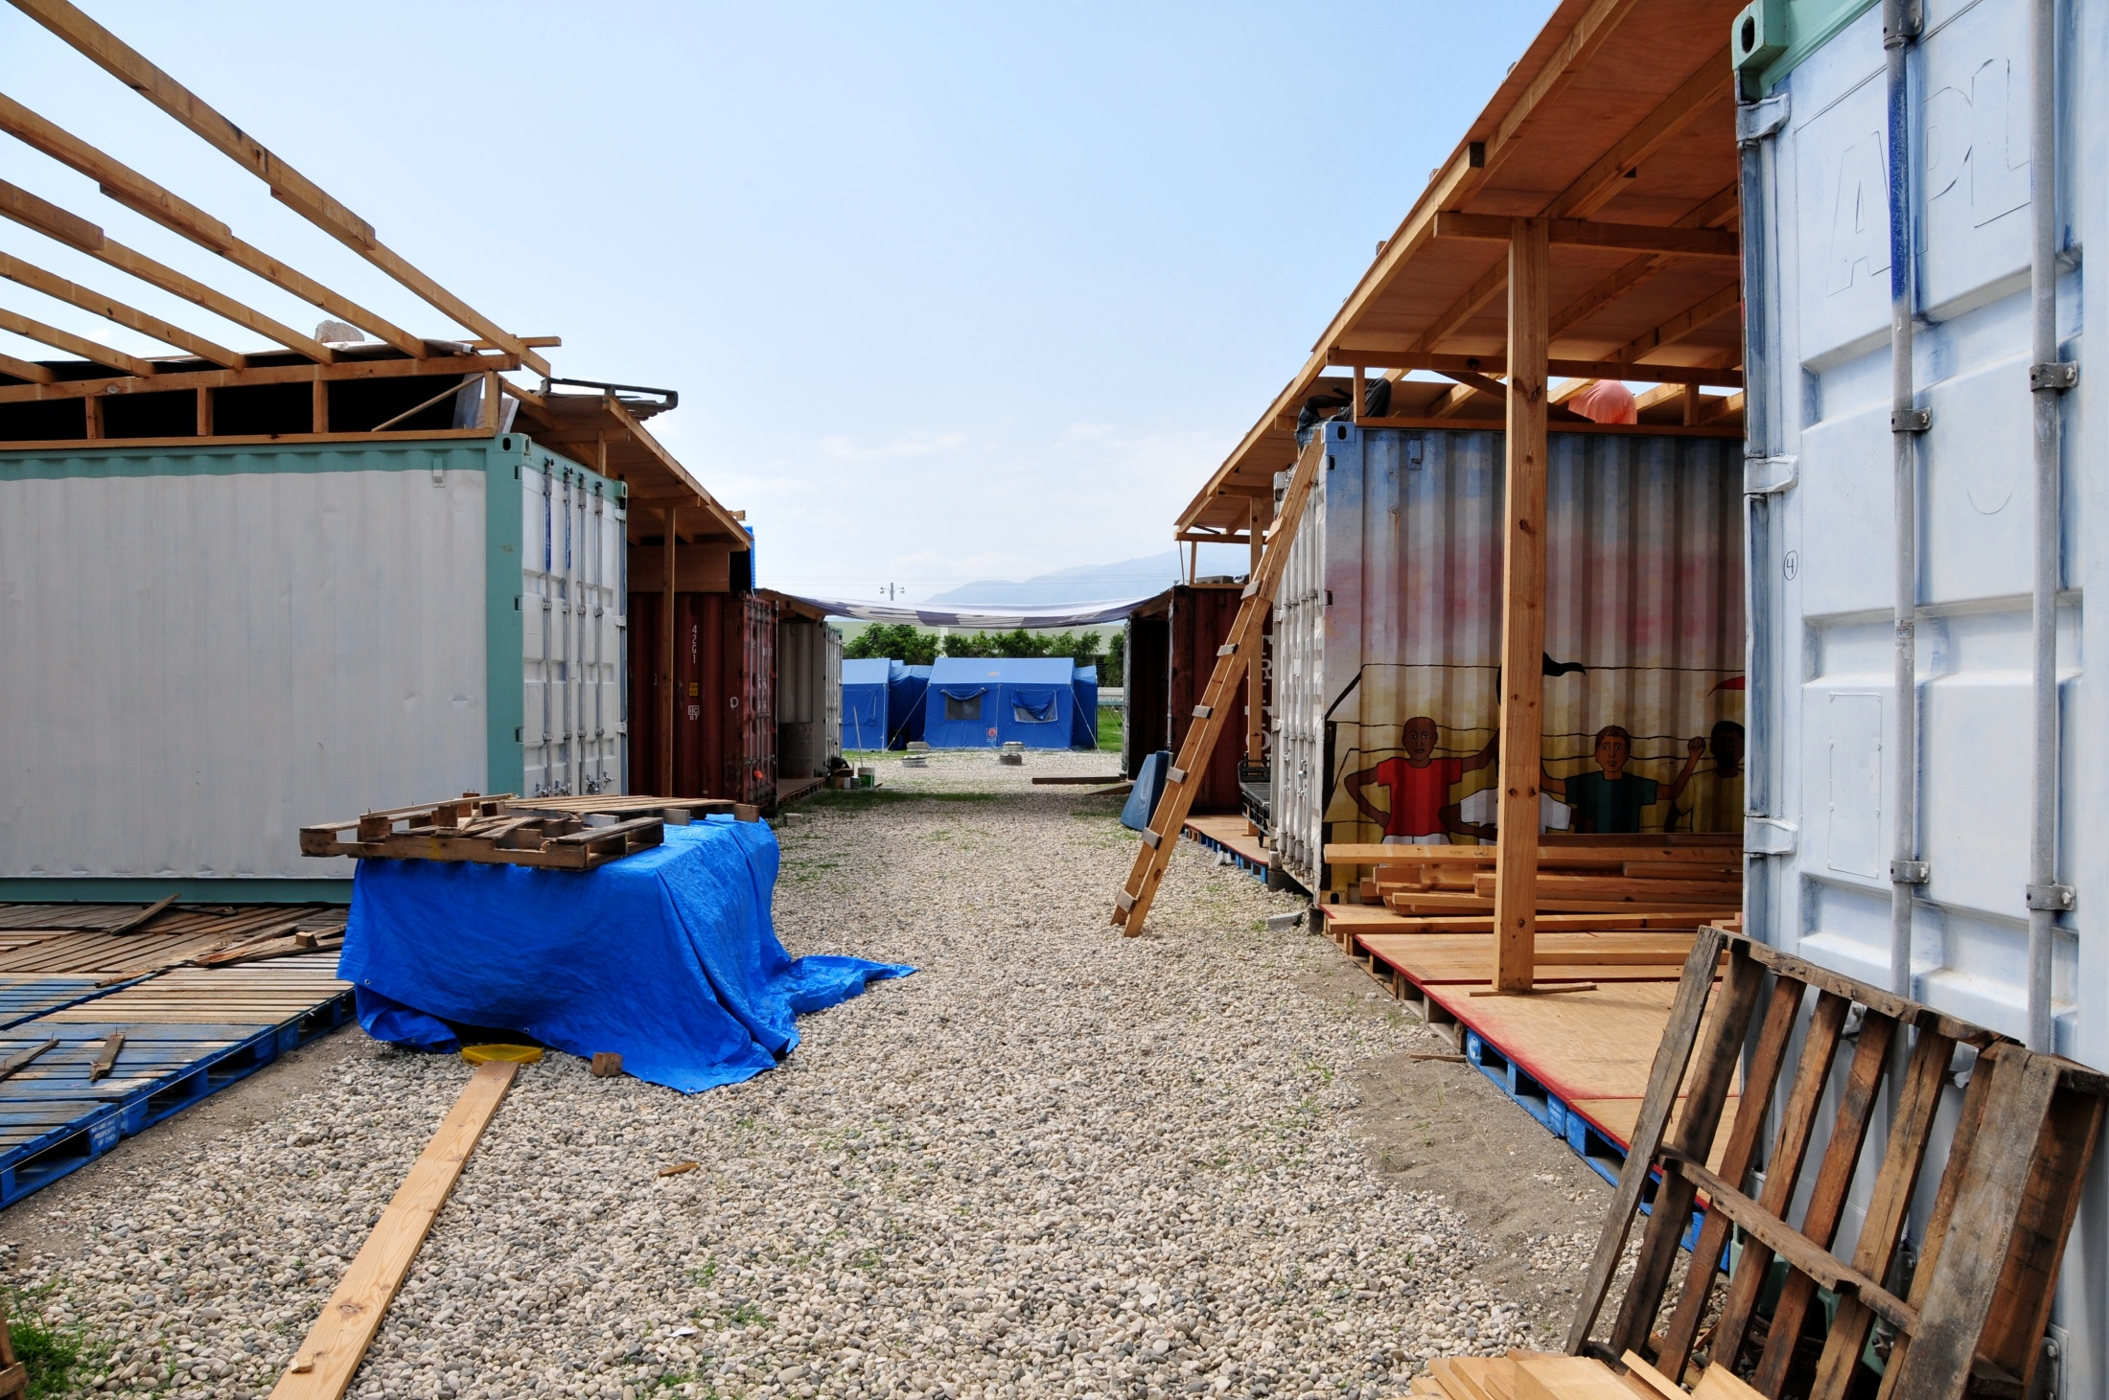
Medical Center

Slide 32
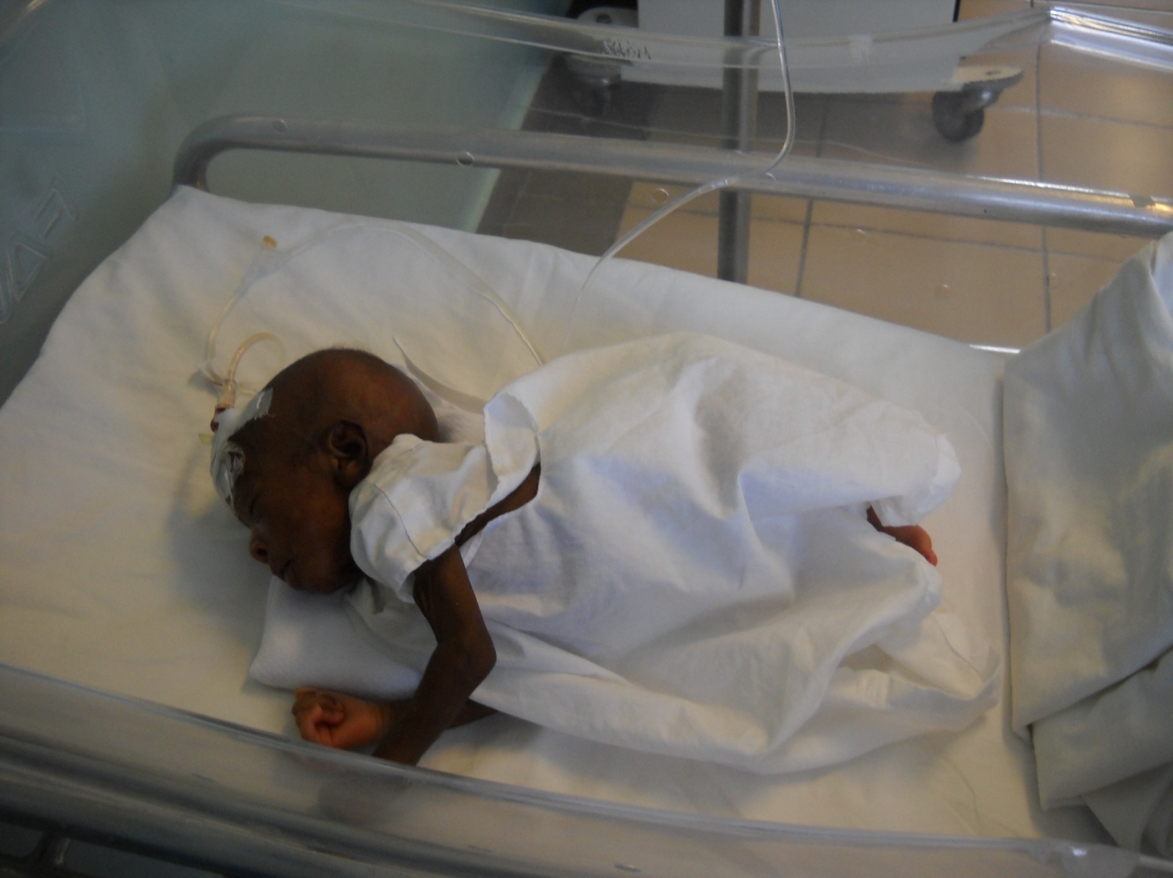
Neo Natal Care

Slide 33
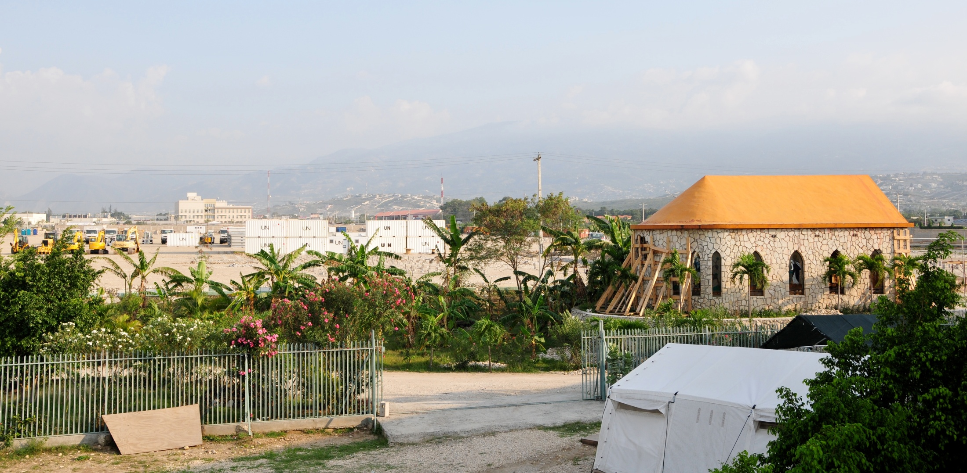
Chapel

Slide 34
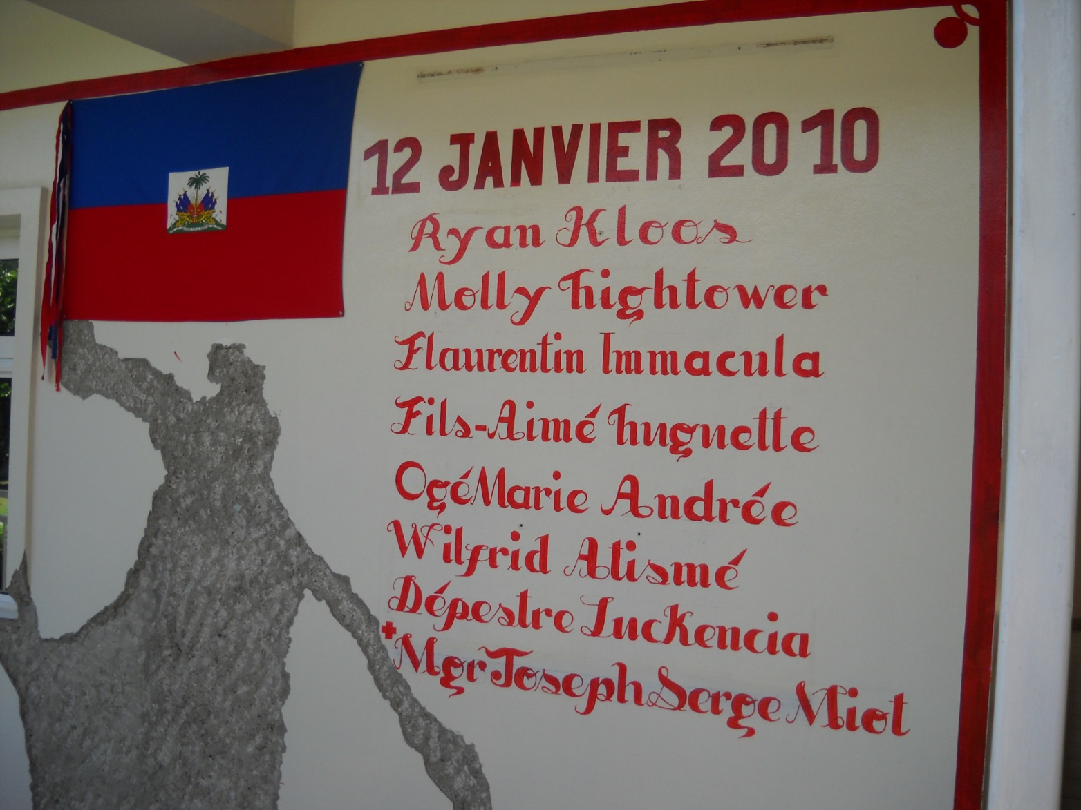
Memorial

Slide 35
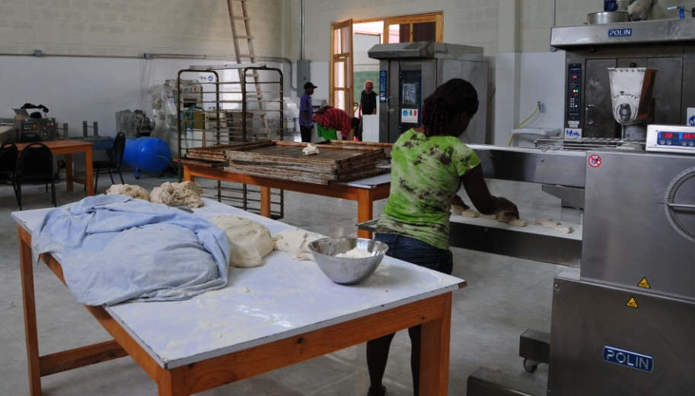
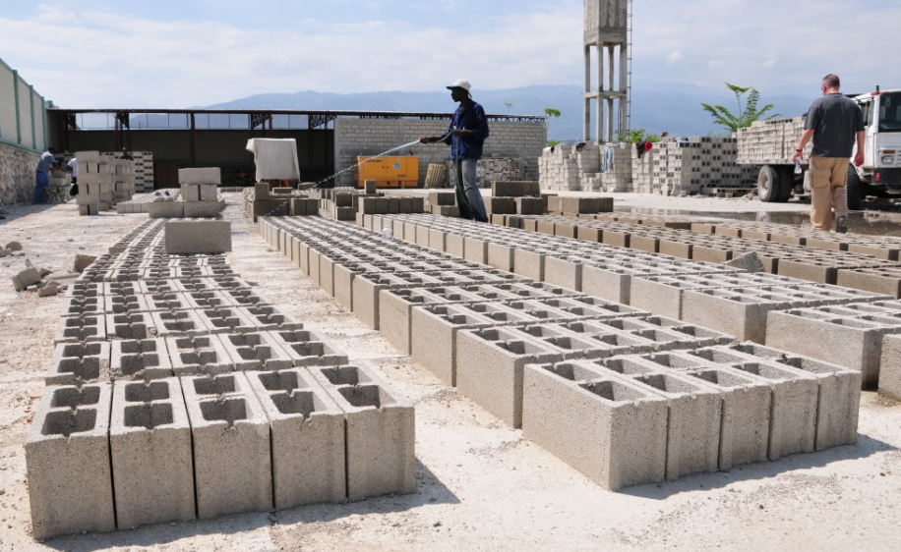
Economic Incubator
Bakery
The world outside the orphanage is brutal and harsh; one of NPH’s concerns is to teach Pequeños skills that they can use when the leave the care of the orphanage Francisville is an example of what can be done – it includes a small bakery and a small brick manufacturing press, through which Pequeños can learn about the basics of enterprise.
Brick Press

Slide 36
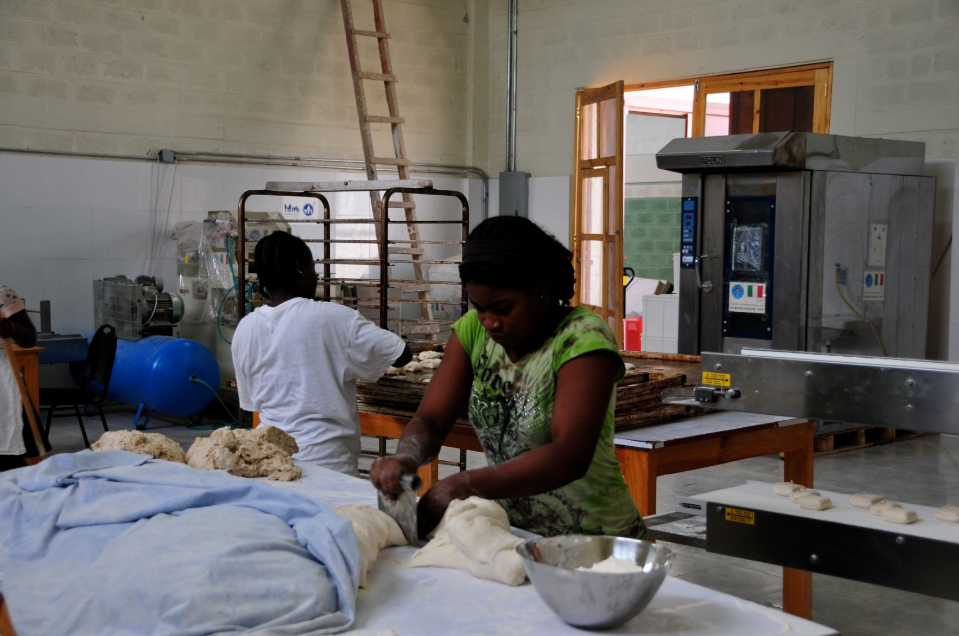
Bakery

Slide 37
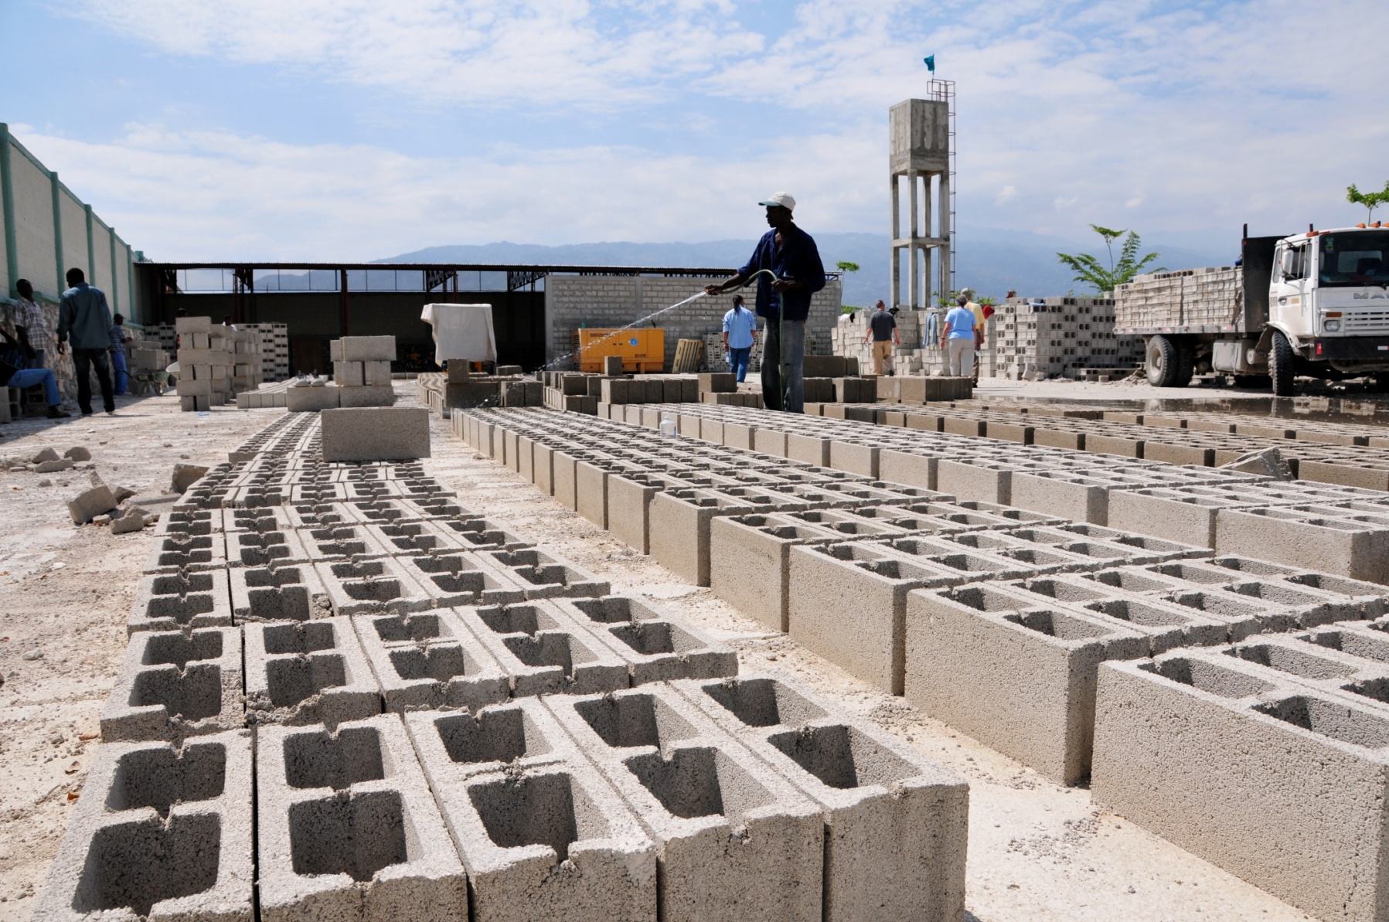
Brick Press

Slide 38
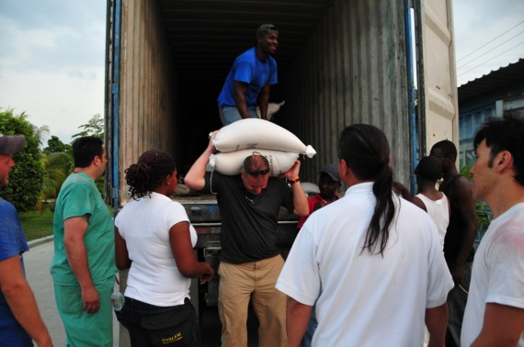
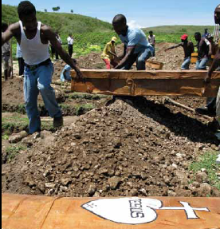
Outreach Programs
Food Distribution
Water Distribution
The Outreach Program caters to the sick and dying in the slums and on the streets. There are over 130 ex- pequeños employed in St Luke programs, along with190 staff. Services include food distribution and water distribution
Among the services provided by the Outreach Program is burial of the dead – providing a modicum of dignity. Since the earthquake, this means placing several bodies in each papier-mâché coffin.
Burial
Select Programs | Annual Budget (pre-Earthquake)
Indigent Burials | $52,000
Water Truck | $36,000
Food Distribution | $240,000
Disaster Relief | $82,000
Street Schools | $576,000

Slide 39
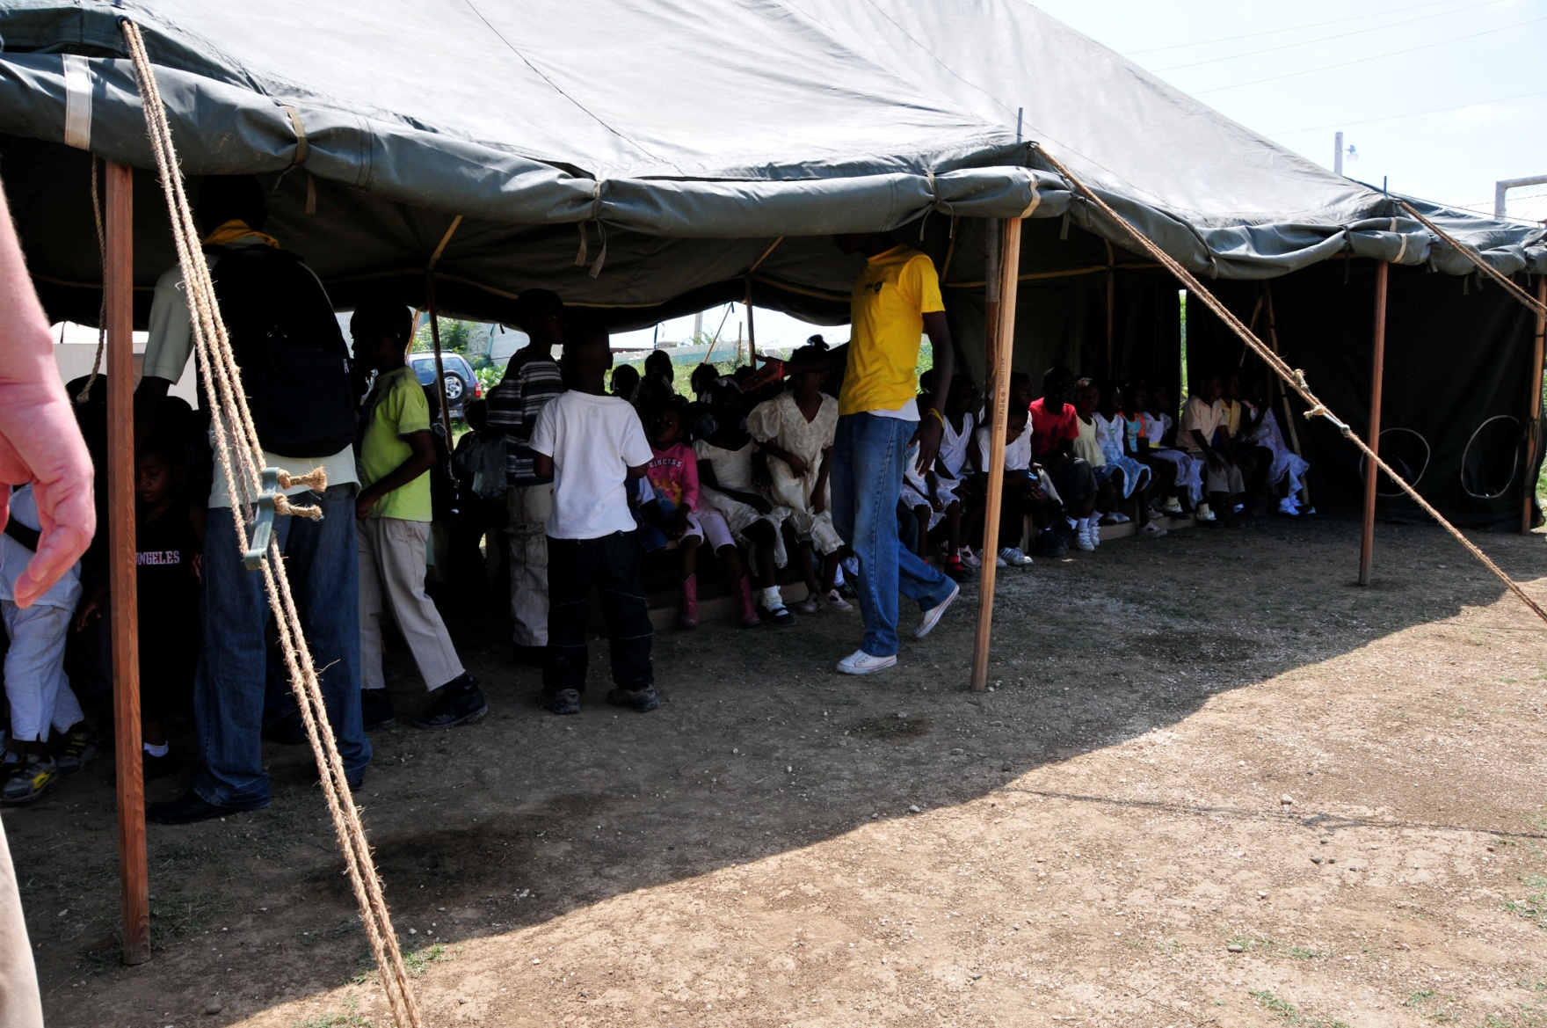
Outreach Programs

Slide 40
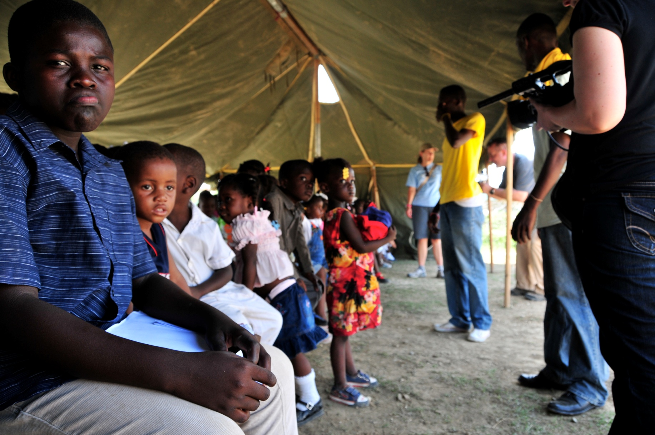

Slide 42
The Orphanage
The Orphanage is a permanent home for orphaned and abandoned children, where they are provided with food, clothing, shelter, medical care and an education.

Slide 43
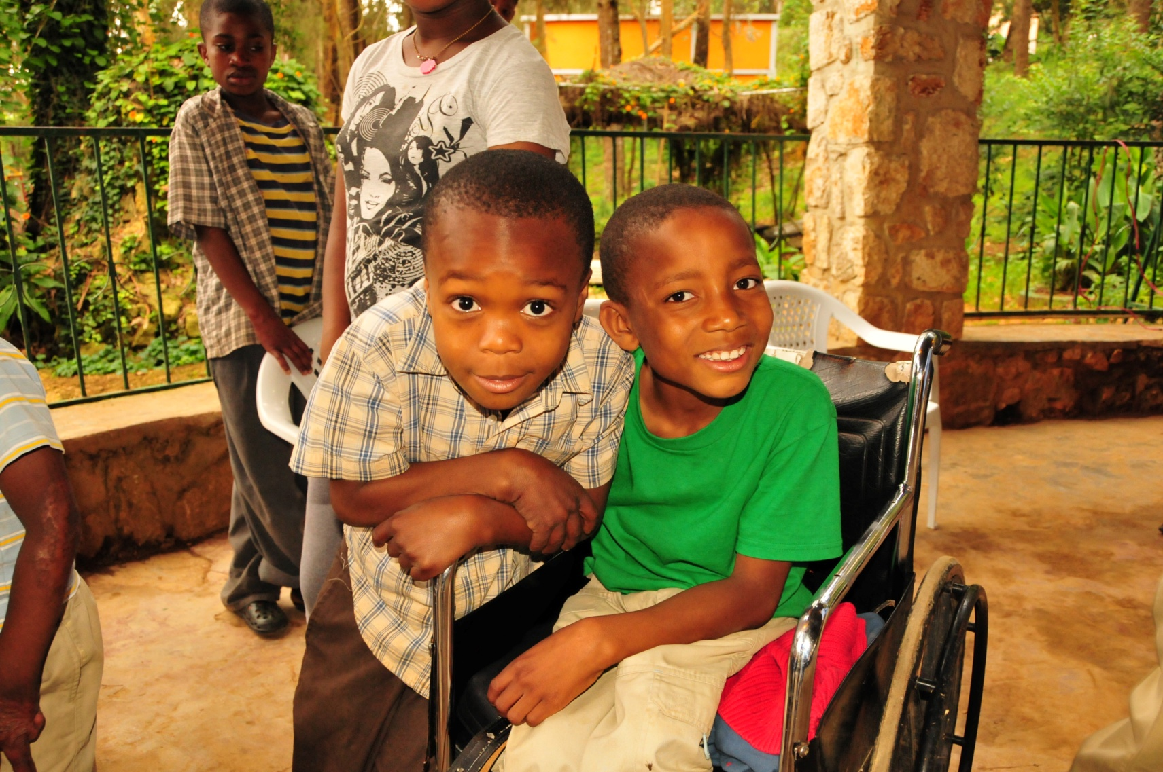
Orphange

Slide 44
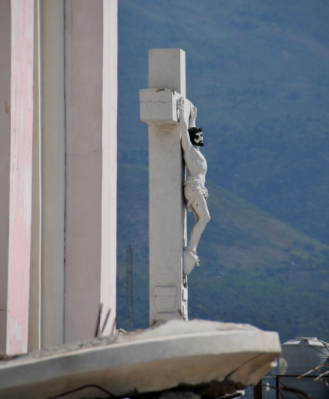
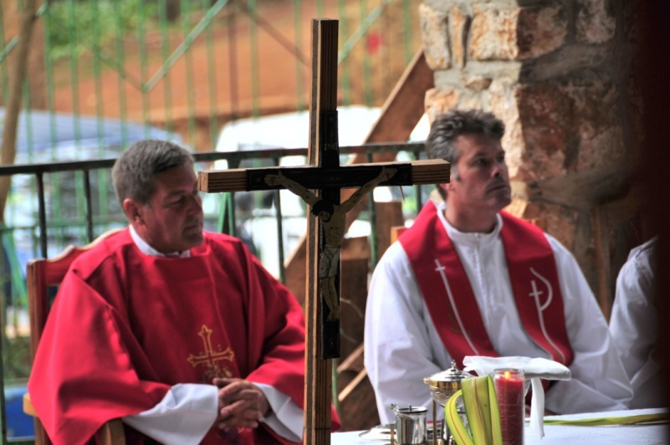
Faith
Matthew 25:40
…“I tell you the truth, whatever you did for one of the least of these brothers of mine, you did for me”.

Slide 45
Additional Traits of Entrepreneurship
Faith
Grace + Guts + Grit
Resourcefulness
Courage

Slide 46
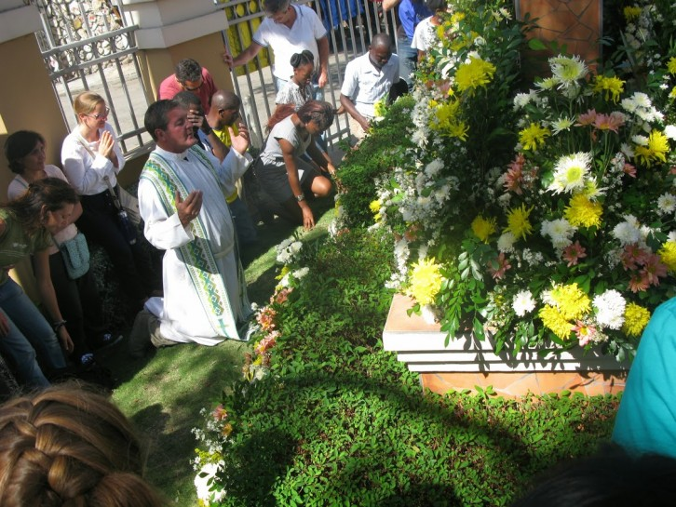

Slide 47
www.nphusa.org

