Slide 1
Rationales for Problem Based Learning in the New Chemistry Curriculum or Why don’t we lecture all of the time?
Chemistry Department

Slide 2
Guided Inquiry
A Guided Inquiry classroom consists of students working in teams on specially designed guided inquiry materials.
These materials guide students toward formulation of their own valid conclusions.
The instructor serves as facilitator, observing and periodically addressing individual and classroom-wide needs.

Slide 3
Improved Teaching
Guided Inquiry is based on research indicating that
Teaching by telling does NOT work for most students.
Students who are part of an interactive community are more likely to be successful.
Students develop greater ownership over the material when they are given an opportunity to construct their own understanding. This leads to improved comprehension and retention of concepts.
Students learn that logical thinking and teamwork are prized above simply getting "the correct answer."

Slide 4
Why Teamwork?
Reason 1: Collective IQ is higher in groups!
Researchers at Carnegie Mellon University found that collaborative groups who conversed easily with equal participation were more efficient at completing sets of given tasks — and produced better results — than groups dominated by individuals.
In two studies with 699 individuals, working in groups of two to five, researchers found that converging evidence of a general collective intelligence. This "c factor" is not strongly correlated with the average or maximum individual intelligence of group members but is correlated with the average social sensitivity of group members, the equality in distribution of conversational turn-taking, and the proportion of females in the group.
Groups can solve harder and more interesting problems
Woolley, Science, October 2010.

Slide 5
Why Teamwork?
Reason 2:
Employers Want Employees with Teamwork Skills
70 biotech companies in MN surveyed for top characteristics wanted in employees
So do graduate and professional schools
Runquist and Kerr, J. Chem. Ed., 2005, 82 (2), p231.

Slide 6
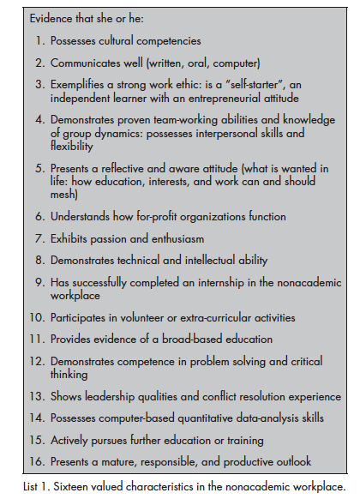

Slide 7
Why Teamwork?
Reason 3:
Death Rates (hospitals and airlines)
Recent study in VA hospitals indicates that Surgical Teams that had been trained in teamwork skills had 20% fewer deaths!!!
Mortality rates decreased after every quarter of training and after every increase in the degree of briefings and debriefings conducted at a facility. The researchers found active communication among surgical team members to be the greatest benefit of the training.
JAMA, 2010;304(15):1693-1700.

Slide 8
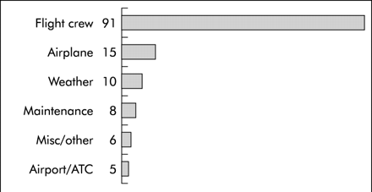
Why Teamwork?
Reason 3:
70% of the airline accidents and incidents over the past 20 years are related to crew communication, workload management, and decision-making skills.
Crew Resource Management Training developed by NASA has been adopted by commercial airlines and railroads worldwide due to success.

Slide 9
What is good teamwork?
Present at all meetings
Prepared for topic
Good communication
Willing to Listen to teammates
Active Participant/Contributing ideas
Able to resolve differences of opinions
In Science article, researchers found that groups where one person dominated tended not to come up with as balanced and thoughtful a result as groups with good communication.

Slide 10
Why Guided Inquiry?

Slide 11
Why Guided Inquiry?

Slide 13
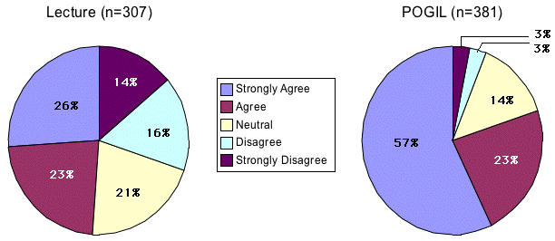
The data shown in the figure below represent students' responses to the following statement:
"I would recommend the method of teaching used in this course to a student taking this course next year."

Slide 14
Conclusions
Students achieve greater “success” in Guided Inquiry classrooms
Regardless of whether success is defined as persistence, grades, retention of material or student satisfaction
Students develop teamwork and communication skills

