Slide 1
Student Employee
and
Team of the Year
Recognition Celebration
April 12th, 2011

Slide 2

STUDENT Employee of
the Year Nominees
College of Saint Benedict
and
St. John’s University

Slide 3
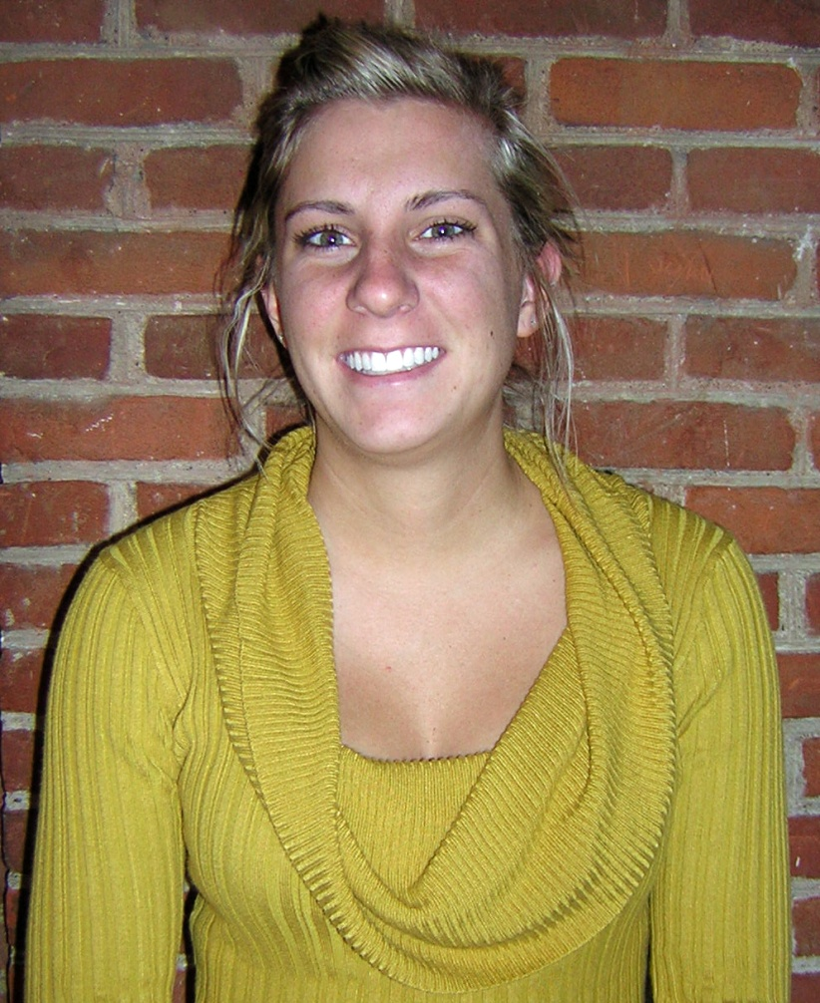
“Had I not been given the experience in, and exposure to, athletics I wouldn’t have realized my passion for sports.”
Laura Deal
CSB Athletics
Supervisor:
Carol Howe-Veenstra

Slide 4
“Laura not only met, but exceeded my expectations in every aspect of our work together. She demonstrated maturity, and a wonderful ‘can do’ attitude that made our time together not only productive but fun.”
Laura Deal
CSB Athletics
Supervisor:
Carol Howe-Veenstra

Slide 5
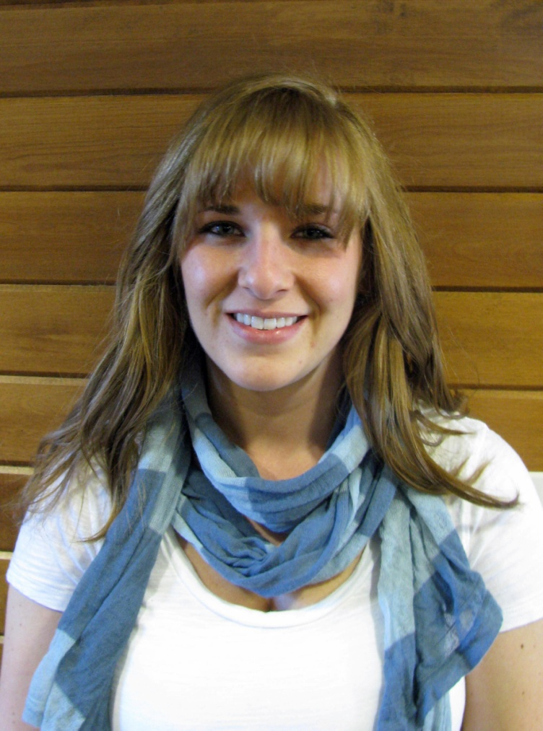
“I am very grateful for the opportunities I was given to work with such wonderful individuals, as well as for the freedom I was given to grow in my own leadership style and grow as an individual.”
Jessica Florek
O’Connell’s/
McGlynn’s - CSB
Supervisor:
Rebecca Terwey

Slide 6
“Wherever Jess gets hired next, they will have an employee who knows what to do, how to do it, and works for the best business outcome!”
Jessica Florek
O’Connell’s/
McGlynn’s - CSB
Supervisor:
Rebecca Terwey

Slide 7
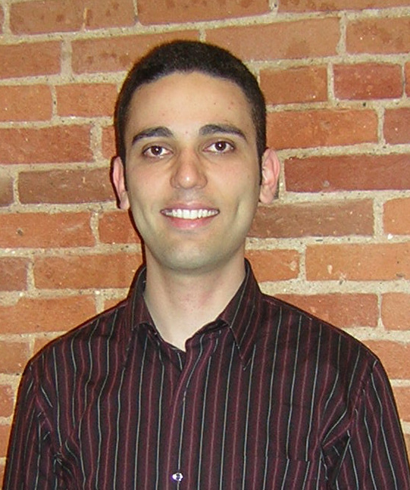
“I have always been interested in creating useful software. This experience gave me hands on experience with software engineering.”
Nibras Hanna
IT Services
Supervisor:
Randy Hammond

Slide 8
“He proficiently designs, programs, and troubleshoots complex web-based applications that positively impact members of the CSB/SJU campus community.”
Nibras Hanna
IT Services
Supervisor:
Randy Hammond

Slide 9
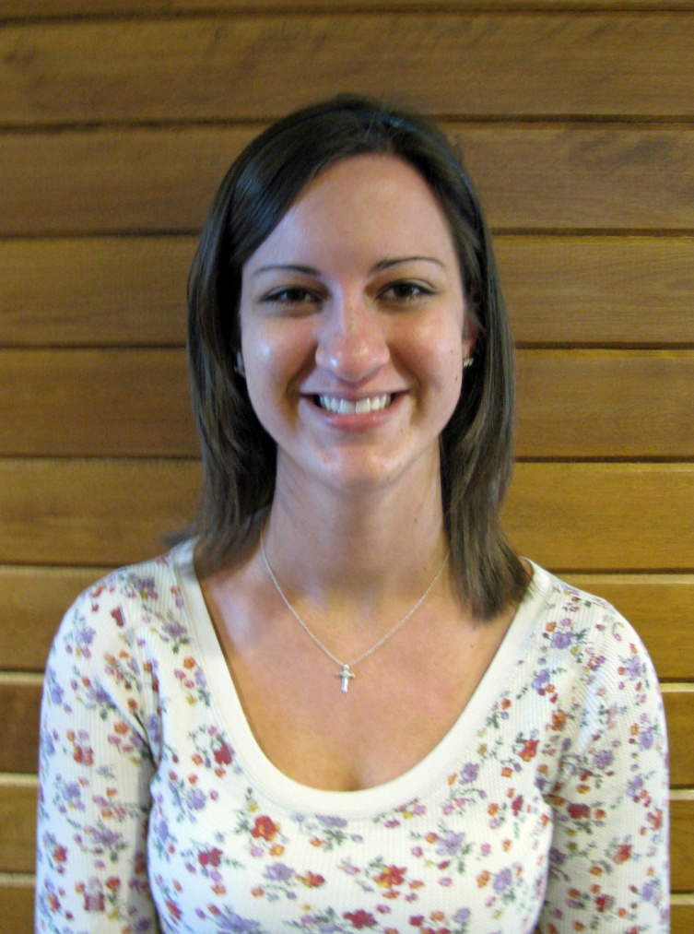
“This position has strengthened my ability to work well independently and take the initiative to make things better.”
Rachel Heying
CSB/SJU Library
Technical Services
Supervisor:
Don Neu

Slide 10
“Through the years I have been her supervisor, the high quality of her work has shown me that I can trust her judgment and consistency.”
Rachel Heying
CSB/SJU Library
Technical Services
Supervisor:
Don Neu

Slide 11
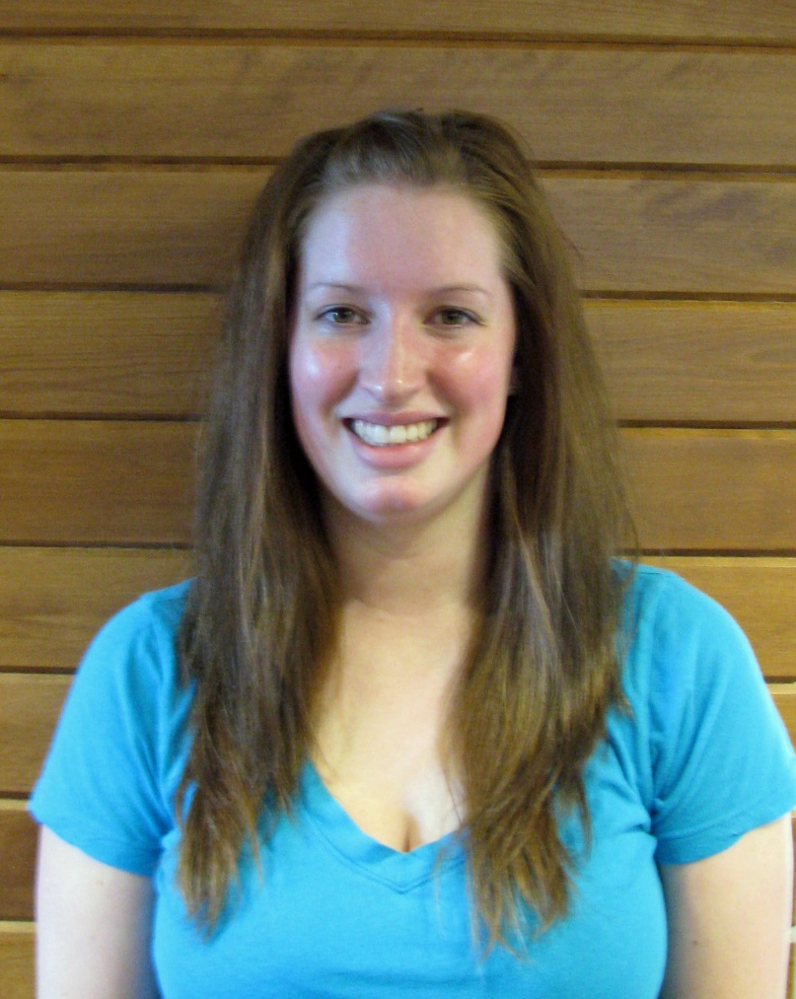
“I believe that the quality of professionalism that I have learned, will carry on into my future career as a physician, when acting in a professional manner is essential to adequate patient care.”
Allison Homstad
Communication & Marketing Services
Supervisor:
Mike Durbin

Slide 12
“In a very visible job, her work presents the success of CSB athletics to athletes, faculty, staff, alumni, prospective students, and fans.”
Allison Homstad
Communication & Marketing Services
Supervisor:
Mike Durbin

Slide 13
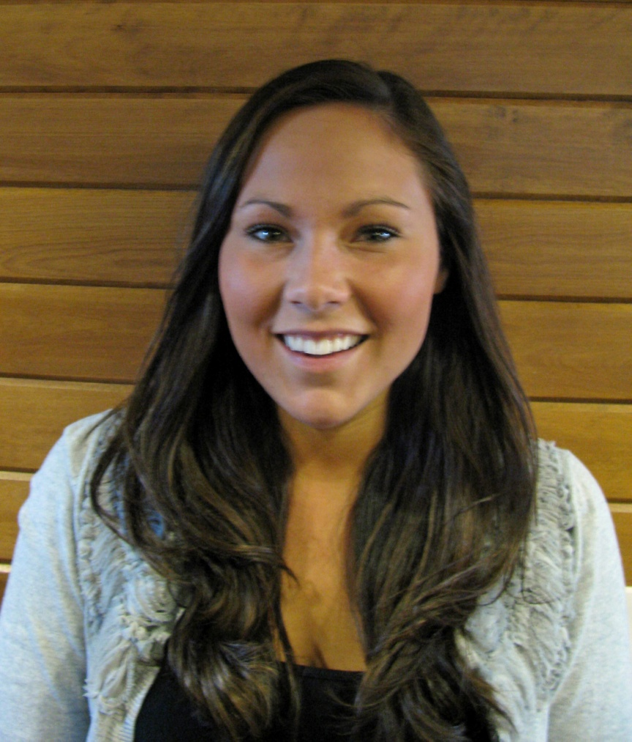
“Being a student employee of Saint Ben’s has provided me with numerous tools that I have been able to use academically, as well as many skills that will prove to be essential in my future professional career.”
Kelley McCormack
Financial Aid/
Student Employment
Supervisor:
Michelle Hemmesch

Slide 14
“Kelley has excelled in her financial aid position because she can effectively explain complex financial ideas to people that may have little to no knowledge.”
Kelley McCormack
Financial Aid/
Student Employment
Supervisor:
Michelle Hemmesch

Slide 15
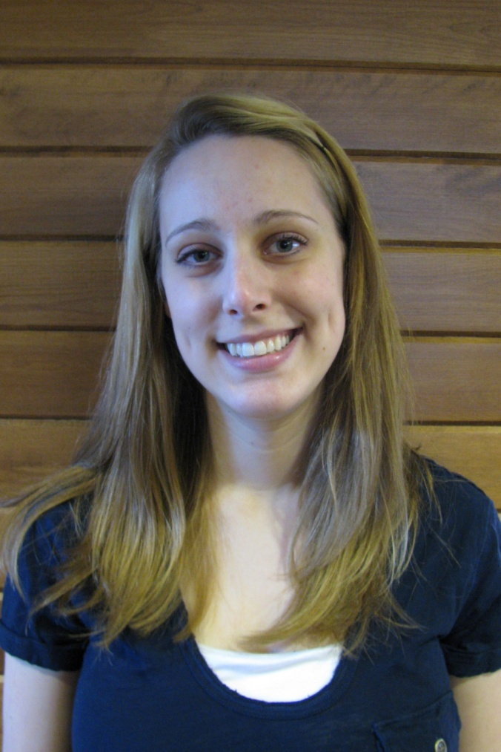
“I am able to set goals for myself that keep me focused and on track one week at a time.”
Melanie Miesen
CSB Athletics
Supervisors:
Carol Howe-Veenstra Deanne Hollermann

Slide 16
“Melanie’s investment in her time here as a student employee has left a mark that will long be remembered.”
Melanie Miesen
CSB Athletics
Supervisors:
Carol Howe-Veenstra Deanne Hollermann

Slide 17
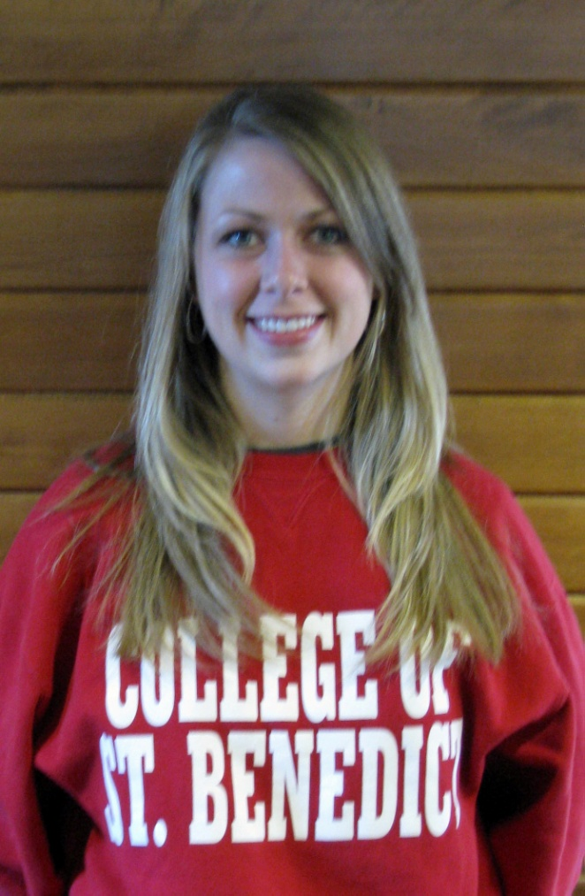
“My on-campus student employment position in SALD has been an amazing part of my journey to self-discovery.”
Meggan Reinert
Student Activities & Leadership Development
Supervisor:
Maribeth Overland

Slide 18
“Her reliability, quality of work and self initiative were above and beyond expected in every capacity.”
Meggan Reinert
Student Activities & Leadership Development
Supervisor:
Maribeth Overland

Slide 19
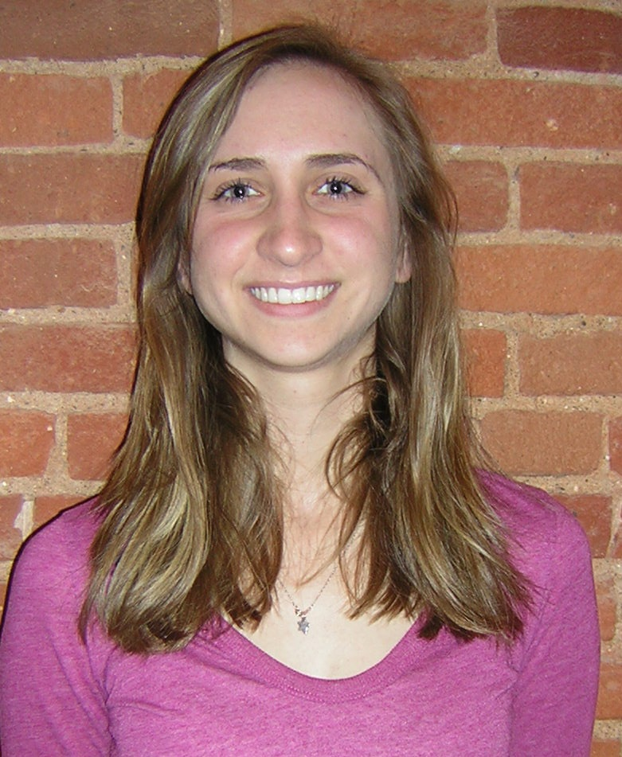
“Overall, this job has formed me into a more responsible and organized human being.”
Katelynn Sobraske
St. Joseph Lab School
Supervisor:
Linda Heinen

Slide 20
“She assumes responsibility cheerfully and works cooperatively and energetically to accomplish any goal.”
Katelynn Sobraske
St. Joseph Lab School
Supervisor:
Linda Heinen

Slide 21
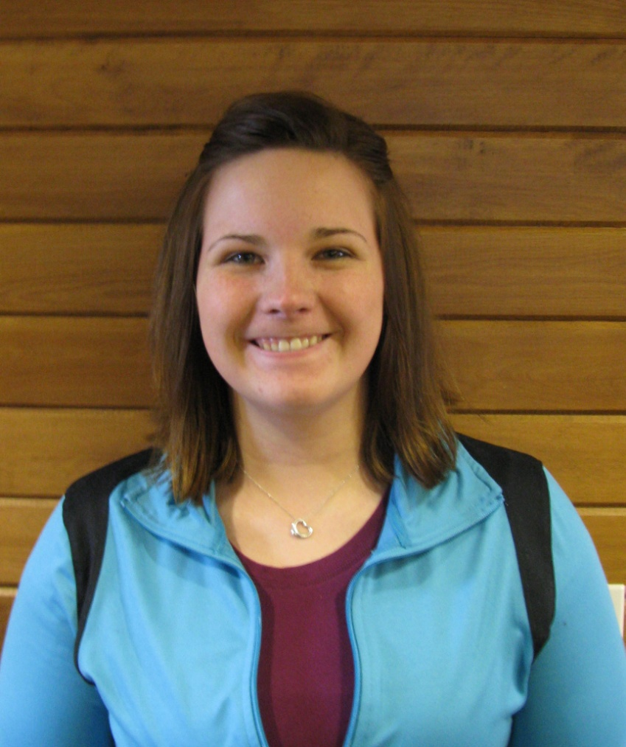
“I am a senior management major, and my student employment position has been a great way to practice the skills
I am learning in class.”
Amanda Wesley
Campus Recreation
Supervisor:
Marcia Mahlum

Slide 22
“I have great confidence in her abilities to see and understand the depth and breadth of the operations of our department.”
Amanda Wesley
Campus Recreation
Supervisor:
Marcia Mahlum

Slide 23
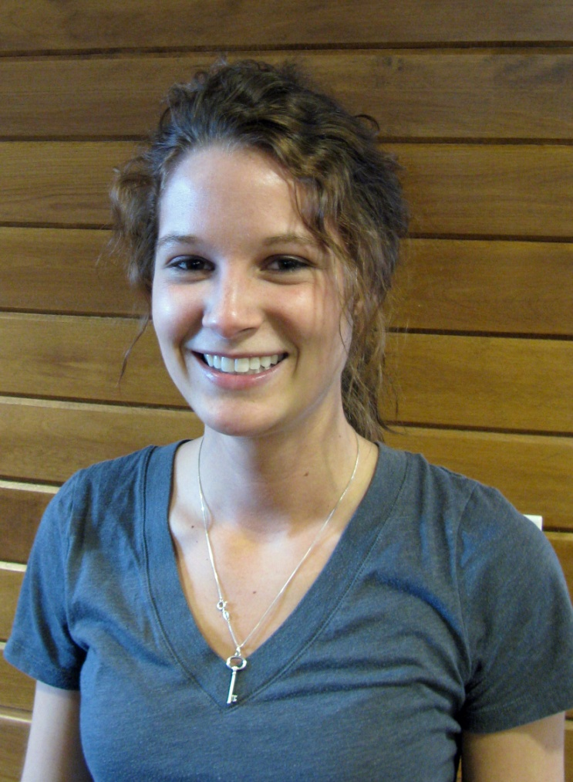
“My job has allowed me to enhance my skills when communicating with others, especially when working with multiple individuals at a time.”
Erin Wiese
Admissions Office
Supervisor:
Angie Arens

Slide 24
“As a tour guide, Erin has outstanding communication skills and she continues that in her position this year.”
Erin Wiese
Admissions Office
Supervisor:
Angie Arens

Slide 25
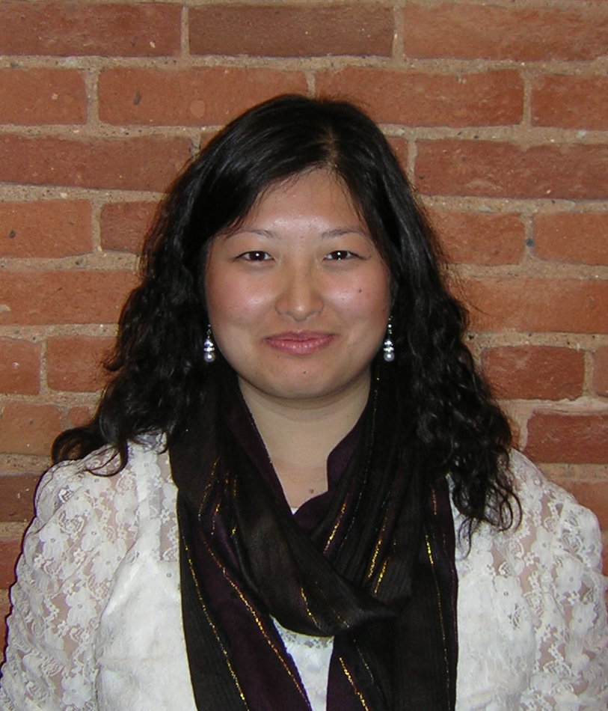
“I love my job in that I became a source of guidance for my friends who had questions on student employment or financial aid.”
Zoua Yang
Financial Aid/Student Employment Office
Supervisor:
Barb Fahnhorst

Slide 26
“Zoua has embraced her role as an essential employee in the financial aid/student employment office and continues to develop transferable life skills to assist her in her life beyond college.”
Zoua Yang
Financial Aid/Student Employment Office
Supervisor:
Barb Fahnhorst

Slide 27
STUDENT Team of the
Year Nominees
College of Saint Benedict
and
St. John’s University

Slide 28
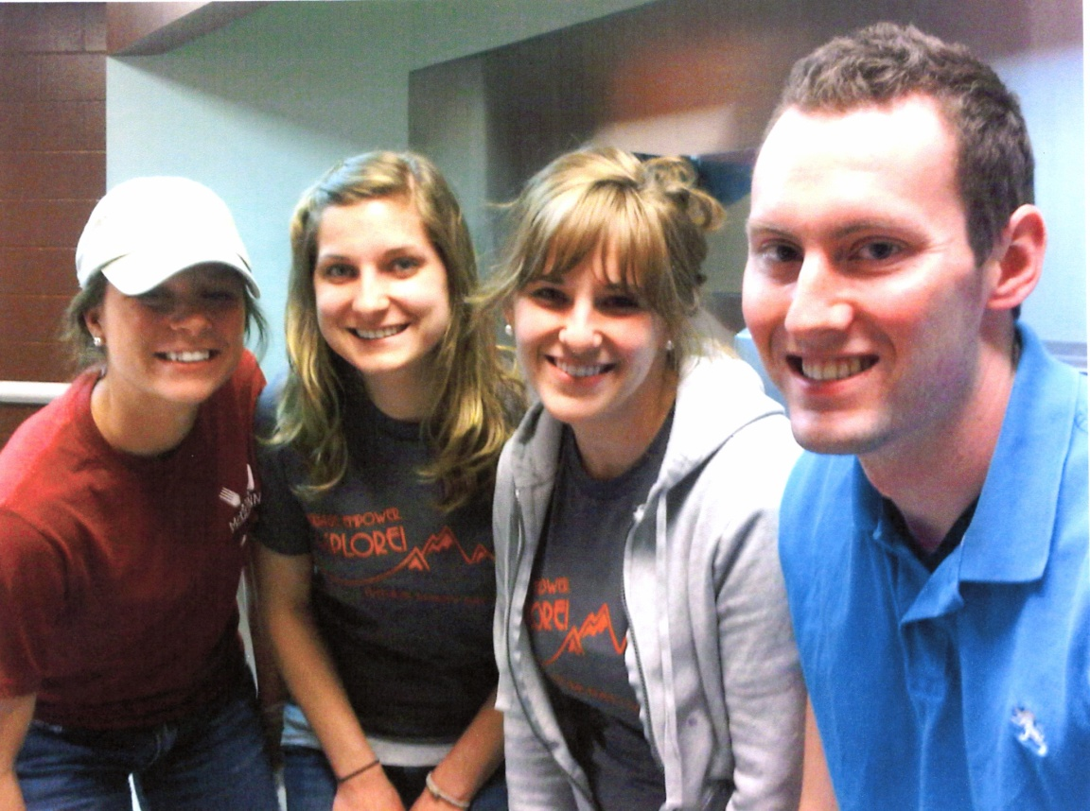
“They worked as a cohesive group, openly communicating their needs and expectations of each other and being a support system through stressful times.”
McGlynn’s/O’Connell’s - CSB
Jessica Florek
Patrick Spaniol
Kindra Boelke
Abigeal Roche
Supervisor:
Rebecca Terwey

Slide 29
“We count on each other for many different tasks and we all work better together.”
McGlynn’s/O’Connell’s - CSB
Jessica Florek
Patrick Spaniol
Kindra Boelke
Abigeal Roche
Supervisor:
Rebecca Terwey

Slide 30
“I am very proud of the hard work that our management team and staff have dedicated to making the McGlynn’s reopening a great success.”
McGlynn’s/O’Connell’s - CSB
Jessica Florek
Patrick Spaniol
Kindra Boelke
Abigeal Roche
Supervisor:
Rebecca Terwey

Slide 31
“We’ve truly developed a great trust in each other as a team of student managers, and we’re extraordinarily proud of the work we’ve accomplished.”
McGlynn’s/O’Connell’s - CSB
Jessica Florek
Patrick Spaniol
Kindra Boelke
Abigeal Roche
Supervisor:
Rebecca Terwey

Slide 32
“Working with such an incredible team makes even the toughest aspects of the job manageable, and the enthusiasm and dedication that they bring to the job acts as encouragement each day.”
McGlynn’s/O’Connell’s - CSB
Jessica Florek
Patrick Spaniol
Kindra Boelke
Abigeal Roche
Supervisor:
Rebecca Terwey

Slide 33
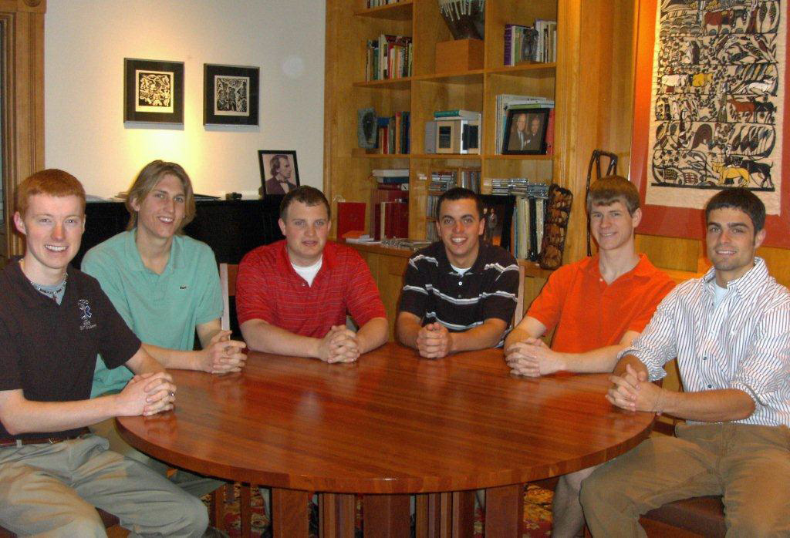
“Our team, as well as the operations of the president’s office, reap the benefits through increased teamwork, efficiency, and productivity.”
SJU President’s Office
Bjorn Anderson
Lucas Goodwin
Matthew Herdering Bryton Overton
James Renier
Kevin Welle
Supervisor:
Mary Ann Haws

Slide 34
“Each time we work together great, original ideas are presented that enable each of us to become more efficient at work, and increase the overall production of our team exponentially.”
SJU President’s Office
Bjorn Anderson
Lucas Goodwin
Matthew Herdering Bryton Overton
James Renier
Kevin Welle
Supervisor:
Mary Ann Haws

Slide 35
“Communication is often stressed as an important tool for our team's success. We collaborate consistently to think of ways to make tasks easier and clearer for everyone.”
SJU President’s Office
Bjorn Anderson
Lucas Goodwin
Matthew Herdering Bryton Overton
James Renier
Kevin Welle
Supervisor:
Mary Ann Haws

Slide 36
“As we work together we learn more, teach each other more and, as a whole, become more efficient.”
SJU President’s Office
Bjorn Anderson
Lucas Goodwin
Matthew Herdering Bryton Overton
James Renier
Kevin Welle
Supervisor:
Mary Ann Haws

Slide 37
“I have learned many valuable lessons through our team meetings and group training.”
SJU President’s Office
Bjorn Anderson
Lucas Goodwin
Matthew Herdering Bryton Overton
James Renier
Kevin Welle
Supervisor:
Mary Ann Haws

Slide 38
CONGRATULATIONS
TO ALL
NOMINEES!

